Slide 1
Focus on
Effectiveness and Outcome Measures
#3 in the Nine-part Series
David Vance
Executive Director

Slide 2
Logistics for Today’s Webinar
  Members can access All PPTs and Recordings anytime on the website at Members Resource Center page.
  PowerPoint and link to recording will be sent within 24 hours.
  To ask a question during the webinar, type a question in the Question box
We will take questions at the end, too

Slide 3

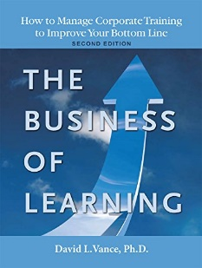


Your Facilitator
Executive Director, Center for Talent Reporting
Founder and Former President, Caterpillar University
  2005 1st Place in ATD BEST Awards
  2006 CLO of the Year
Former Chief Economist, Caterpillar Inc.
  Ph.D. in Economics, Masters in Business Administration
Author, The Business of Learning (second edition), and Measurement Demystified (2021) & Measurement Demystified Field Guide (2022) with Peggy Parskey (ATD Press)
Adjunct Professor in Human Capital Development
  Bellevue University (PhD program)
  University of Southern Mississippi (PhD program)
  George Mason University (Executive Education program)
Member, ISO Working Group on Metrics

Slide 4
The Center for Talent Reporting:
The Home of TDRp
Established October 2012
  Nonprofit, member-based professional association (like ATD)
Mission
  Improve and standardize the measurement, reporting, and management of human capital to deliver significant business value
Offerings
  Webinars
  Measurement and Reporting Workshops
  Coaching
  Annual conference
  Corporate memberships
  Certification and accreditation

Slide 5


Our Partners
We want to thank the following partners for their support of the Center for Talent Reporting.
PLATINUM PARTNER
Explorance is a Founding Partner

Slide 6


Our Partners
We want to thank the following partners for their support of the Center for Talent Reporting.
BRONZE PARTNERS
Bellevue University Human Capital Lab and ROI Institute are Founding Bronze Partners

Slide 7


Today’s Discussion
Review of Measurement Framework and Efficiency Measures
Focus on Effectiveness Measures
Focus on Outcome Measures
Conclusion
Notes:
POLL #1: What is your HR Function (check all that apply)
Learning & Development
Leadership Development
Capability Development (career planning and progression)
Talent Acquisition
Other

Slide 8
Review of TDRp Framework and Efficiency Measures

Slide 9
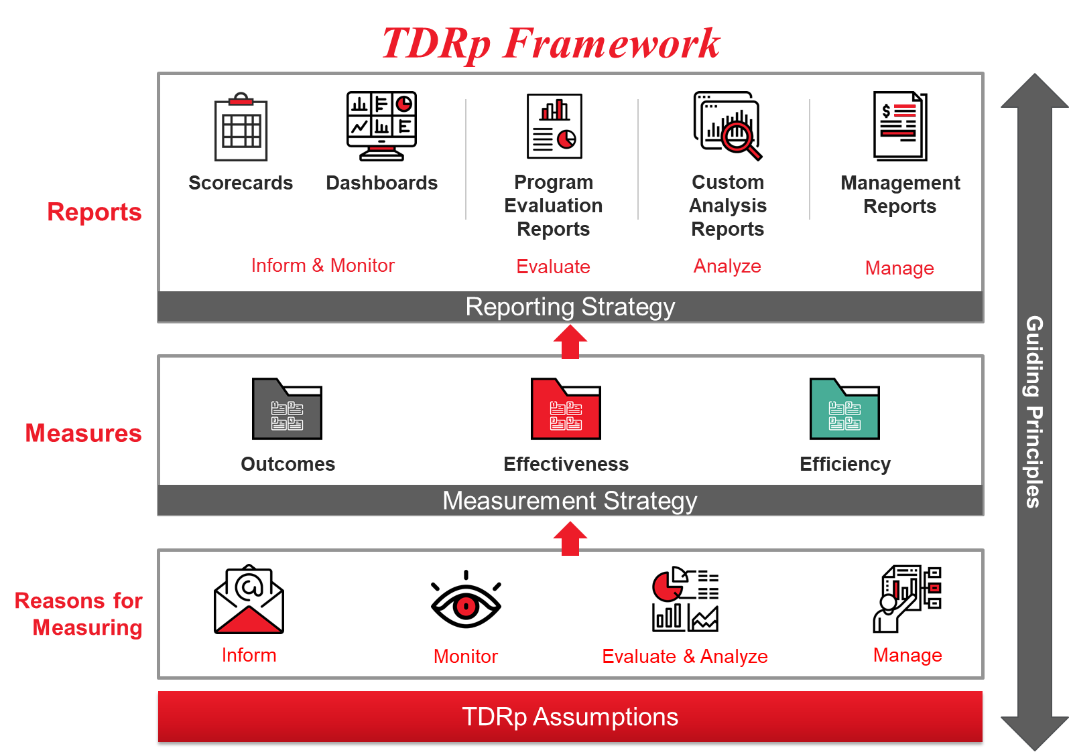

Slide 10
The Three Types of TDRp Measures
Efficiency: quantity, volume, utilization or cost of program or initiative
  For individual programs and for enterprise overall
  Examples: Number of participants, courses, hours; cost, completion dates, utilization rates, cycle times
Effectiveness: quality of program or initiative
  For individual programs and for enterprise overall
  Examples: Participant reaction to training, goal owner reaction, learning, application, reinforcement, supervisor support, ROI
Outcomes: impact of learning initiatives on organizational goals
  Will be a different set for each organization because goals and initiatives are different.
  Common outcome measures are impact of learning on: sales, cost, quality, employee engagement, leadership score, and customer satisfaction

Slide 11
A Good Measurement Strategy Will Contain All Three Types
Choosing just effectiveness or efficiency measures will lead to unintended consequences
  Choose just effectiveness and efficiency will suffer
  Choose just efficiency and effectiveness will suffer
Without outcome measures it will be impossible to demonstrate
  Impact
  Value
Remember, the primary purpose of L&D is to contribute to an organization’s success, to its outcomes

Slide 12
Focus on Effectiveness Measures

Slide 13
Effectiveness Measures
More powerful than efficiency measures
Used to evaluate course or program effectiveness
In L&D we focus on five categories of effectiveness measures

Slide 14

L&D Effectiveness Measures
Katzell/Kirkpatrick/Phillips five levels provide a framework
  Level 1: Reaction or Satisfaction, Relevance, Recommendation
  Level 2: Learning
  Level 3: Application (intended and actual) or behavior
  Level 4: Results or Impact (actual and estimated)
  Level 5: Value (net benefit or ROI)
Others: level of manager support and reinforcement
Most today still measure only levels 1 and 2
  Although the number regularly measuring levels 3-5 is increasing

Slide 15

Level 1: Reaction or Satisfaction
For Participants
Measures participant reaction to the learning
Via a survey immediately following class
Typical questions
  Was it relevant to your work?
  Would you recommend this course to others?
  How would you rate the instructor?
Five-point Likert scale recommended
  Results reported as raw score (like 4.1) or % choosing top two boxes (87%)
Usually applied to all courses
  Not necessarily all participants

Slide 16
Level 1: Reaction or Satisfaction
For Goal Owners
Measures satisfaction with the learning department
Via a survey following completion of the program or at 3-6 intervals for long programs
Typical questions
  How was L&D to work with?
  Did L&D deliver on time and on budget?
  Would you recommend L&D to your colleagues?
  Five-point Likert scale recommended
    Results reported as raw score (like 4.1) or % choosing top two boxes (87%)
  How could L&D improve? (open ended)
Recommended for all key initiatives

Slide 17
Level 2: Learning
Measures transfer of knowledge: did you learn?
By test as you take the course or at completion
  Goal owner or SME has set the passing score
  May be automated
Ways to report results
  Final score (like 92%)
  Number of attempts required to pass when participant must keep taking the course until reaching minimum passing score, or score on first attempt
Use depends on nature of the learning
  Appropriate whenever participant is expected to retain specific content: compliance, competency attainment, etc.
  Affords legal protection

Slide 18
Level 3: Application or Behavior
Measures application of learning
Two forms
  Intent to apply: Measured immediately after course as a leading indicator of actual application
    This question can be included in the post-event survey along with L1 questions and L4 estimated impact
  Actual application: Usually measured 3-6 months after course completion (Research indicates about 80 days required to establish new behavior)
    This question can be asked in the follow-up survey along with L4 actual impact
    There are cases where actual application must be determined immediately after course completion (call centers, bank tellers, etc.)
By survey, observation, or completed action plan
Should be done for all key programs, often with Level 4 and 5

Slide 19
Level 3: Application or Behavior (continued)
Questions for both measures for survey
  Intent to apply
    “I plan to apply what I learned in this course on the job”
      Results reported as % of participants selecting top two boxes or raw score
    “What percentage of the content of this course do you think you will be to apply on the job?”
      Results reported as average % applied. (1-% applied = % scrap)
  Actual application
    “I have applied what I learned in the course”
      Results reported as % of participants selecting top two boxes or raw score
    “What percentage of the content of this course have you applied on the job?”
      Results reported as average % applied. (1-% applied = % scrap)
    “Describe one thing you are doing differently as a result of the course you took.”
      Results reported as % doing at least one thing differently
Observation by supervisor or expert may also be used for actual application
  Results reported as % who correctly applied knowledge or behavior
Action plans
  Completion often requires application

Slide 20
Level 4: Results and Impact
Level 4 is defined differently by Kirkpatrick and Phillips
  Kirkpatrick defines it as Results
  Phillips as Impact
We will examine both in greater detail in a moment
Note, though, that some do measure results (not necessarily in Kirkpatrick terms) several ways in surveys
  Improvement in job performance
  Met goal owner or leader expectations for contributing to the achievement of the goal
  Both can be measured using a 5 or 7-point Likert scale

Slide 21
Level 4: Phillips Impact
Measures the isolated impact of learning
Metric is usually one that is already reported regularly. Examples
  Sales
  Number of injuries
  Leadership score on Employee Engagement survey
Five ways to calculate
  Control group
  Trend line
  Regression
  Participant estimation
    Initial and Final
  Expert opinion
Level 4 Impact is also the preferred outcome measure

Slide 22

Level 5: ROI
Measures the Return on Investment (ROI) and Net Benefit from learning
Assigns dollar benefits to the Level 4 impact of learning and then compares the benefits to the costs
  Formula: ROI = Net benefit / Total cost
  Where
    Net benefit = Gross benefit (dollar value of the impact) – Total cost
    Total cost = All costs of the training including the opportunity cost of participant’s time
Strongly recommended for high impact, high cost programs

Slide 23
ROI Example
Say Level 4 impact was 30% reduction in injuries
Your safety engineers tell you the value of the 30% reduction is $250,000 (Gross benefit)
Net benefit = Gross benefit – Total cost of training
If total cost of training was $150,000
Then Net benefit = $250,000 - $150,000 = $100,000
ROI = Net benefit / Total cost
  = $100,000 / $150,000 = 67%
Generally, any ROI greater than 25% or 30% is good

Slide 24
Most Common Effectiveness Measures for L&D

Slide 25

Minimum Recommended Effectiveness Measures
At a program level
  Level 1 Participant reaction
  Level 1 Goal owner reaction
  Level 2 as appropriate
  Level 3 for most programs
  Levels 4 and 5 for key programs
At a department level
  Average & distribution of level 1 participant reaction
  Average & distribution of level 1 goal owner reaction
  Average & distribution of level 2 as appropriate
  Average & distribution of level 3 for most programs
  Summary of levels 4 and 5 for key programs

Slide 26
Focus on Outcome Measures

Slide 27
Outcome Measures
The most powerful type of measure
Shows the impact of learning on the organization’s goal
In the TDRp framework, Phillip’s level 4 isolated impact is the desired outcome measure
  If not feasible, then a Kirkpatrick approach to meeting goal owner expectations and/or improvement in job performance

Slide 28
What Is Impact?
Impact is the contribution to a business or HR goal from a learning program or initiative
  Requires the isolation of the contribution from learning
For example,
  You might have a sales training program in support of a goal to increase sales by 10%
    If sales rise by 9%, how much of the 9% increase was due to training?
  You might have a goal to increase employee engagement by 3 points
    If engagement increases by 2.5 points, how much of the 2.5 point increase was due to learning?

Slide 29

Outcome Measures
The impact of your initiatives on the organization’s goals
  May be expressed quantitatively or qualitatively
Examples
  Impact of learning on sales
  Impact of learning on quality
  Impact of learning on patient or customer satisfaction
  Impact of learning on employee engagement)
Bottom line, some measure of impact or success will be needed

Slide 30
What CEOs Want (2010)
Research from Jack and Patti Phillips:
Notes:
OK…. So what do Managers want us to report to them? (Business Results)
They want , in Kirkpatrick terms, level3 (application- behavior changes), level 4 (Impact), and Level 5 (ROI)
What do we normally provide them (Training results)
- cheeks in seats
- how much it costs
- How satisfied attendees were with the course
It hasn’t changed much!

Slide 31
How Much Progress Have We Made?
Level of Measurement 2019
Level 1: Reaction | 83%
Level 2: Learning | 80%
Level 3: Behavior | 54%
Level 4: Results | 38%
Level 5: ROI | 16%
None | 5%
L&D still focuses a great deal of energy on gathering and reporting activity and cost data.
CEOs want more focus on behavior, results and ROI.
Sources
2019: ATD: Effective Evaluation Measuring Learning Programs for Success
2015, 2009 : ATD: Evaluating Learning: Getting to Measurements That Matter
2002: ASTD 2002 State of the Industry Report

Slide 32


Background and Context
The Katzell/ Kirkpatrick Four Levels (40s-60s)
  Level 1: Reaction
  Level 2: Learning
  Level 3: Behavior
  Level 4: Results
In the 1970s Jack Phillips
  Redefined Level 3 to be Application
  Redefined Level 4 to be Impact
  Added Return on Investment (ROI) as Level 5
    ROI=Net Benefit / Program Cost
    Where Net Benefit is the monetary value of impact

Slide 33
Results Versus Impact
Kirkpatricks (Don originally, now Jim and Wendy) focus on results
  Did the business or HR measure improve after the training?
  Can you establish a compelling chain of evidence that training played a role in the improvement?
    Training -> X -> Y -> Results
      Sales training -> More prospect calls -> More proposals -> Higher sales
  If so, the training contributed to the results
So, results do not reflect the isolated contribution from training
  They do not believe it can or should be isolated (who gets the credit issue)

Slide 34
Results Versus Impact (continued)
Phillips (Jack and Patti) focus on isolated impact and ROI
  Not sufficient to know that the business or HR measure improved when training was provided.
  Need to know how much of the improvement was due to training
  Without isolated impact how do you know if the training was worthwhile (positive ROI)
    Training may have an impact but still not be worth doing
“Isolation issue” is one of the most contentious topics in learning
  Primary reason more don’t use Impact and ROI

Slide 35
Return on Expectations (ROE) in a Nutshell
Coined by Don and Jim Kirkpatrick
  Appears in their 2007 book Implementing the Four Levels
  More in Training on Trial by Jim and Wendy Kirkpatrick in 2010
  Also in a T&D article in August 2010 ROE’s Rising Star
ROE is not a number but an approach to answer the question
  “Did we meet our mutual expectations?”
Two key components
  Expectations
    Reaching agreement with the goal owner upfront on what the impact or result of training initiative will be
  Return
    How do the initiative’s results compare to the agreed-upon expectations

Slide 36
The Issue of Isolation
Most controversial aspect of ROI
Various methods to do this
  Control group
  Trend Line
  Forecast using regression
  Participant and manager estimation
  Expert opinion

Slide 37
Control Groups and Trendlines
Control groups
  The gold standard. Only method to provide actual impact
  Isolated impact will be difference between control group and experimental group
  May be naturally occurring control groups
Trendline
  Visual extrapolation
  of trend
  Isolated impact is the
  difference between
  trend and actual

Slide 38
Regression and The Participant Estimation Method of Isolation
Regression
  Statistical technique to estimate the value of a measure based on historical relationships
  Isolated impact will be the difference between the estimated value without training and the actual value with training
  Requires expertise in modeling
Participant estimation: use when other methods not available
  Random sample of 30 or more
  Each estimates the isolated impact
  Each estimates their confidence level
  Multiply the two together for a confidence-adjusted isolated impact
  Average the confidence-adjusted isolated impact from all participants in sample

Slide 39
Example of Participant Estimation Method for Isolating Impact
Say district’s sales increased 9% after training
Isolating the impact of training on the 9% increase in sales
  Ask each sales person for their estimate and confidence level
    John: 80% due to training. 70% confident. Factor is 80%x70%=56%
    Sue: 60% due to training. 50% confident. Factor is 60%x50%=30%
    Gaj: 90% due to training. 80% confident. Factor is 90%x80%=72%
    Tonya: 0% due to training. NA confidence. Factor is 0%
    Jose: 50% due to training. 40% confident. Factor is 50%x40%=20%
  Average all five factors
    (56%+30%+72%+0%+20%)/5 = 178%/5=35.6%
  Multiply the sales increase by the isolation factor
    9% increase x 35.6% = 3.2% increase in sales due just to training

Slide 40
Follow-Up Surveys Used to Determine Final Estimate of Impact
Survey Monkey or vendor generated surveys
  60-90 days after the training
Generic impact questions
  What impact do you believe the training had on your performance
    Decile intervals from 0% to 100%
  A standard confidence factor is then applied to the average answer (50% to 65%)
Custom impact questions
  How much did training contribute to the increase in your sales?
    Decile intervals from 0% to 100%
  How confident are you about this estimate?
    Decile intervals from 0% to 100%

Slide 41
Example Using Data from Generic Survey
Average of 51 respondents = 60%
  Note: if class is only 30 or less, then you need almost everyone to respond. If class is large, you need at least 30. Typical response rate is 30% which is fine. The higher the number and response rate the more confident you can be in the impact
Adopt standard confidence adjustment of 50%
Then, confidence-adjusted isolated contribution from learning is 60% x 50% = 30% contribution from learning
Sales from those who took the training increased by 9% after the training.
Impact from training = 9% x 30% = 2.7% increase in sales due just to training

Slide 42
Example Using Data from Custom Survey
Each participant asked
  How much their sales increased after the training
  How much of this increase was due to the training
  How confident they are in that estimate
Data entered into an excel spreadsheet
  Confidence-adjusted isolated impact calculated for each
    Sales increase x how much due to training x confidence
  Average calculated for all responses
    Suppose it is 2.4%
Impact from training = 2.4% increase in sales due just to training

Slide 43
Recommendation for Outcome Measures
Include anytime L&D is supporting a high-level business of HR goal like sales, productivity, engagement or leadership
May be either quantitative or qualitative
  Quantitative assigns a number to the impact of learning
    Example of quantitative: Sales increased 3% due to learning
  Qualitative assigns an adjective to the impact of learning where the adjectives scale in importance
    Like low/medium/high or important/significant/very significant
    Example of qualitative: Learning had a significant impact on sales
    May be viewed as a way of describing the expectations of the Kirkpatrick approach

Slide 44
Conclusion
Notes:
What is your level of experience in providing executive reports to senior leaders?
Significant experience
Moderate experience
Some experience
No experience

Slide 45
Summary
TDRp Provides a helpful framework to discuss and use three types of measures
  Efficiency measures are about quantities: Foundational
  Effectiveness measures are about quality: More powerful
  Outcome measures are about impact: Most powerful
Effectiveness measures are the five Kirkpatrick/Phillips levels: reaction, learning, application, impact and ROI.
Outcome measures are the isolated impact of learning on the organizational goal. So, Phillips level 4 does double duty.
Next month, focus is on your measurement strategy

Slide 46


Learn More about Measurement & Reporting, TDRp
Measurement Demystified: Creating Your L&D Measurement, Analytics and Reporting Strategy (ATD Press, 2021)
  By David Vance and Peggy Parskey
  The definitive work on TDRp
Companion Measurement Demystified Field Guide (ATD Press, 2022) now available!
Get both on Amazon
  And a guide to reading both simultaneously at TD.org under Measurement Demystified
DV

Slide 47
Measurement Demystified Workshop
The virtual workshop is a series of seven modules (two each month Sep-Nov)
    September: TDRp framework, efficiency and effectiveness measures
    October: Effectiveness & outcome measures and selecting measures
    November: Running learning like a business and reporting
    December: Wrap up
    Each has homework
$499 for CTR members, $749 for nonmembers
Special rate for alums! Only $399
And copy of our new books Measurement Demystified and Measurement Demystified The Field Guide

Slide 48
Ways to Accelerate Your Mastery
Webinars
  TDRp Webinar Series
    Introduction to Measurement, Reporting, and TDR (1/17)
    Focus on Efficiency Measures (2/15)
    Focus on Effectiveness and Outcome Measures (3/27)
    Selecting Your Measures (4/12)
    Reporting & Running Learning Like a Business (5/16)
    The Three TDRp Management Reports (6/14)
    Creating Plan Numbers (7/19)
    Reporting YTD Results and Creating Forecasts (8/9)
    Creating Your Measurement & Reporting Strategy (9/13)
  The New ISO Standard for L&D Metrics (4/19, 5/10)
  Public Reporting: Are You Ready? (3/29, 9/6)
Virtual workshops
  Measurement Demystified
    Sep-Dec: Registration open soon
  The New ISO Standard on L&D Metrics
    June 21: Registration open
  Custom
    1, 2, or 3-day workshops
Virtual coaching
Public Workshop on Implementing TDRP
  November 7-8

Slide 49
Become a Member of the
Center for Talent Reporting
Benefits
  Access to Recordings and PPTs for all 14 webinars
  Access to Enhanced Content on the website
    Formulas and references for over 700 measures
    Excel versions of sample reports
    Detailed implementation guidance
    Members only page
    Business acumen resources
    Case studies
  Discount on workshops and conference
Investment: Only $299

Slide 50
Wrap Up
  PPT and link to Recording sent to all registrants within 24 hours
  All PPTs and Recordings available anytime to members at Member’s Resource Center page
  Contact Dave Vance DVance@CenterforTalentReporting.org with any questions about the recordings or PowerPoints
Questions?

