Slide 1
Reporting and Running Learning Like a Business
#5 in the Nine-part Series
David Vance
Executive Director

Slide 2
Logistics for Today’s Webinar
  PowerPoint and link to recording will be sent within 24 hours.
  To ask a question during the webinar, type a question in the Question box
We will take questions at the end, too
Members can access All PPTs and Recordings anytime on the website at Members Resource Center page.

Slide 3
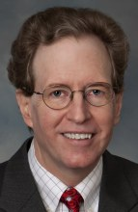
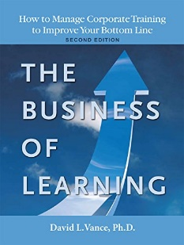


Your Facilitator
Executive Director, Center for Talent Reporting
Founder and Former President, Caterpillar University
  2005 1st Place in ATD BEST Awards
  2006 CLO of the Year
Former Chief Economist, Caterpillar Inc.
  Ph.D. in Economics, Masters in Business Administration
Author, The Business of Learning (second edition), and Measurement Demystified (2021) & Measurement Demystified Field Guide (2022) with Peggy Parskey (ATD Press)
Adjunct Professor in Human Capital Development
  Bellevue University (PhD program)
  University of Southern Mississippi (PhD program)
  George Mason University (Executive Education program)
Member, ISO Working Group on Metrics

Slide 4
The Center for Talent Reporting:
The Home of TDRp
Established October 2012
  Nonprofit, member-based professional association (like ATD)
Mission
  Improve and standardize the measurement, reporting, and management of human capital to deliver significant business value
Offerings
  Webinars
  Measurement and Reporting Workshops
  Coaching
  Annual conference
  Corporate memberships
  Certification and accreditation

Slide 5


Our Partners
We want to thank the following partners for their support of the Center for Talent Reporting.
PLATINUM PARTNER
Explorance is a Founding Partner

Slide 6


Our Partners
We want to thank the following partners for their support of the Center for Talent Reporting.
BRONZE PARTNERS
Bellevue University Human Capital Lab and ROI Institute are Founding Bronze Partners

Slide 7


Today’s Discussion
Review of the TDRp Framework
Reporting
Running Learning like a Business
Management Reporting
Conclusion
Notes:
POLL #1: What is your HR Function (check all that apply)
Learning & Development
Leadership Development
Capability Development (career planning and progression)
Talent Acquisition
Other

Slide 8
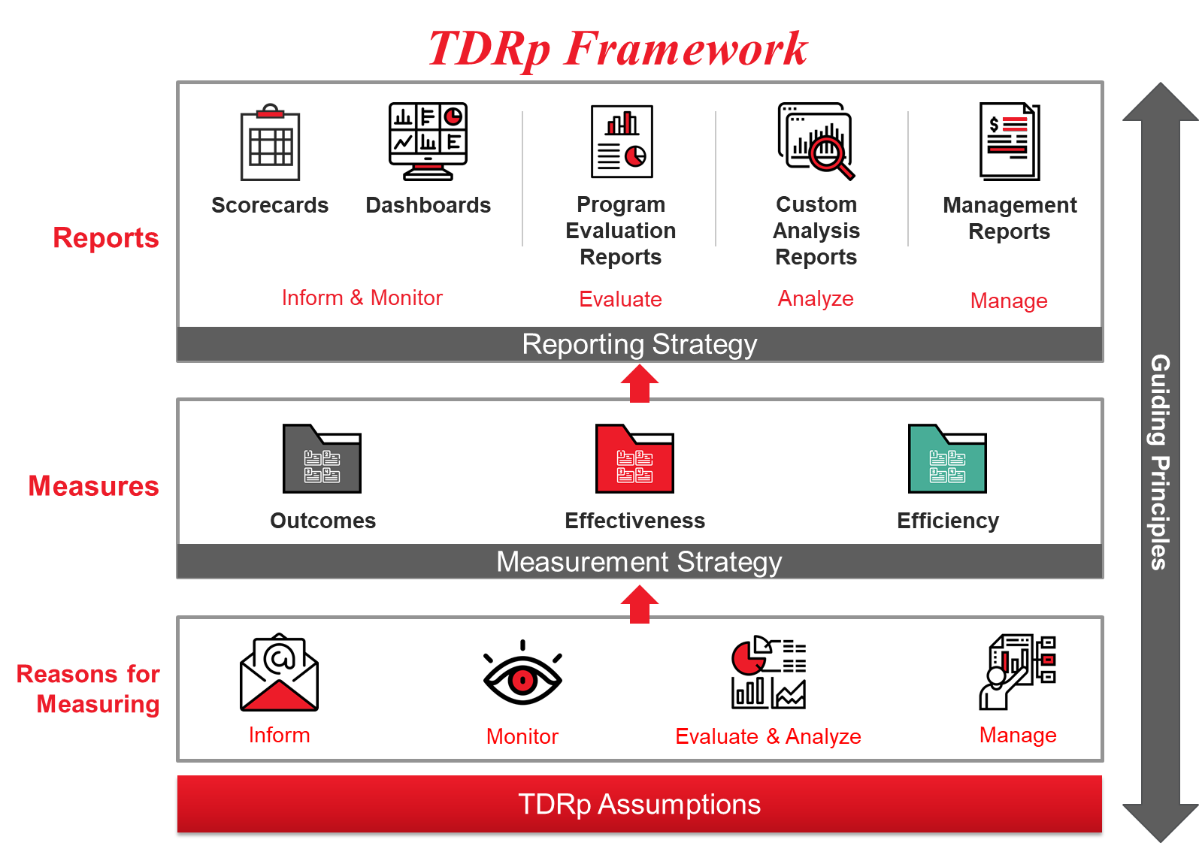

Slide 9
Reasons to Measure
Four broad reasons to measure
  Inform Only
    Answer Qs about activity, identify trends
  Monitor
    Determine if measure is meeting historical expectations
  Evaluate & Analyze
    Determine the efficiency, effectiveness, and impact of a program. Identify opportunities for improvement
  Manage
    Plan, execute, make decisions
    Achieve new levels

Slide 10
Reporting

Slide 11
Reports Are the Connection Between Measures and the Users
The critical role of reports
  Measures => Reports => User
Reports should be designed to provide the user with the information they want
  Single piece of information probably does not require a report
  Multiple data elements generally will
      One measure with multiple elements (number of participants by month)
      Multiple measures each with single element (L1-L3 for the first quarter)
      Multiple measures each with multiple elements (L1-L3 over eight quarters)
  Written report or PPT may be preferred over a table or in addition to it

Slide 12
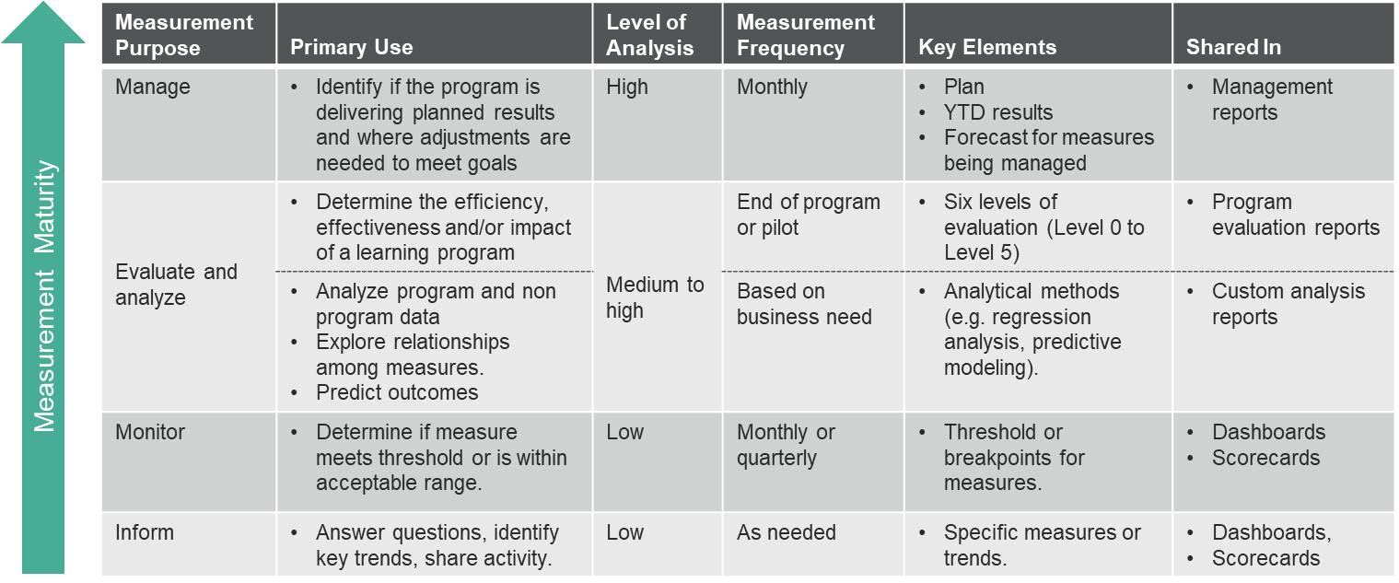
Measurement Requirements by Reason to Measure

Slide 13
Scorecards

Slide 14
Scorecard Summary
Data in tabular form
  Typically, rows are the measures, columns are the time periods
Use scorecards to inform (or monitor)
  Show actual results by month, quarter, year-to-date, year
  May include a comparison to
    Prior month, quarter, year
    Threshold or Benchmark
Scorecards will always be
  Backwards looking
  Static

Slide 15
Example of a Typical Table or Scorecard
Purpose: Inform

Slide 16
Dashboards

Slide 17
Dashboard Summary
Like the scorecard, a dashboard is used for informing or monitoring
Will contain a visual display and/or be interactive
  Speedometer, bar chart, line graph, pie charts
May contain a table but generally will have less data than a scorecard
  Often will have summary measures
May contain a threshold for monitoring
  Often will use color coding to denote status of measure

Slide 18
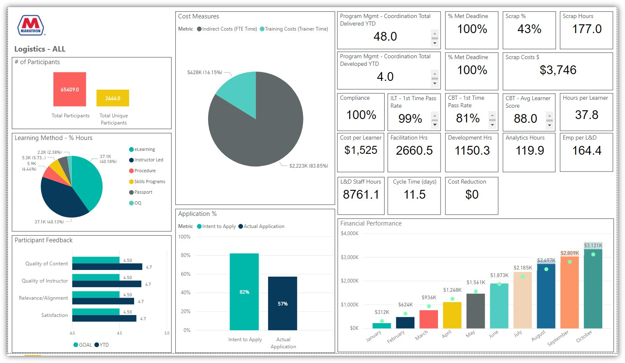
Dashboard Example from Marathon
Purpose: Inform

Slide 19
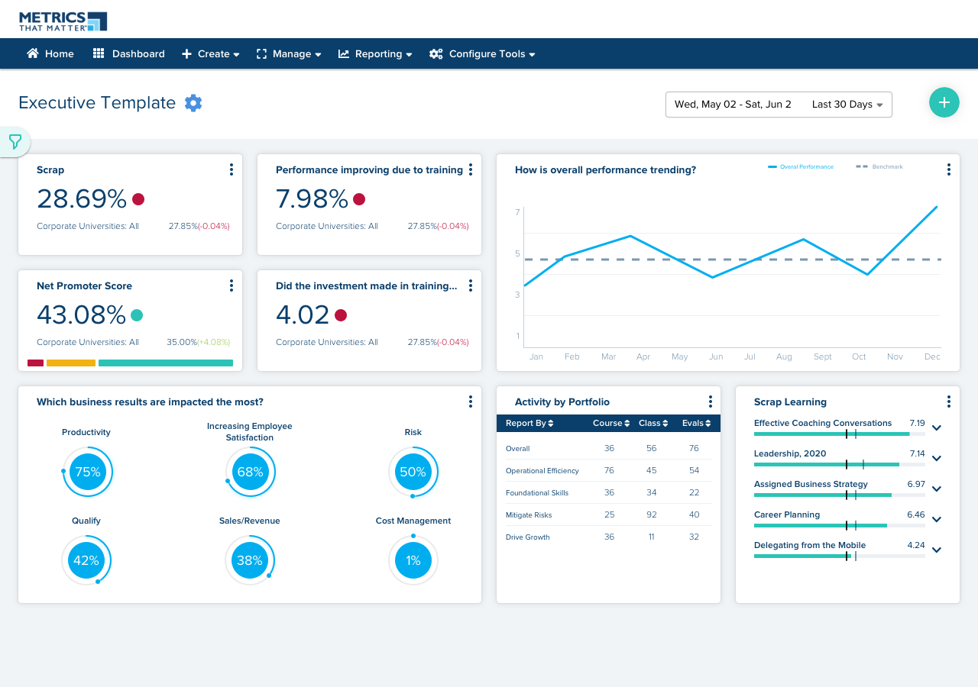
Dashboard Example from MTM
Purpose: Inform

Slide 20
Example of a Departmental Dashboard
Purpose: Monitor

Slide 21
Program Evaluation Reports

Slide 22
Program Evaluation and Custom Analysis Reports
Program Evaluation Report
  Designed to share evaluation results for programs
    A one-off report to share results at the end of a pilot, program
      For example, was the sales training program effective?
    Many varieties. May be PPT or text
  Excellent for project wrap up, identifying opportunities for improvement
Custom Analysis Report
  Designed to share results of research analysis
    A one-off report to share results at the end of a project
      For example, does learning lead to higher employee engagement?
    Many varieties. May be PPT or text
  Excellent for project wrap up, identifying opportunities for improvement

Slide 23
Elements of a Program Evaluation Report
The goal or need to be addressed
The plan to achieve the desired impact or meet expectations
  Plans or targets for all key measures
Results of the implementation
  Key efficiency measures
  Key effectiveness measures
  Results for the key business outcome measure
  ROI of the program (if using Phillips)
  Lessons learned

Slide 24
Example of a Simple Program Evaluation Report
The 2022 Sales Training Initiative
Goal was to help achieve the company goal of 10% higher sales
  Sales and learning departments agreed consultative selling skills and product features training should contribute to 3% higher sales
Extensive training and coaching provided to all 73 sales reps
  Consultative selling skills based on advice of most successful reps
  Expectations to sales reps clearly articulated by VP of Sales
  80 hours of training from January 1 – February 28
  Individual coaching and reinforcement by sales supervisors through June 30
  Monthly meetings between reps and supervisors to review progress
  Incentives for reps and supervisors revised to support the initiative
Effort completed on time and at budgeted cost of $325,000

Slide 25
Example of a Simple Project Summary
(continued)
Training was well received and application rate was high
  90% agreed that the training was a worthwhile investment and would recommend it to others
  84% had applied key concepts and 100% had used the product features training after 90 days
Sample feedback
  “One of the best programs I have ever attended. The content was clear, powerful and relevant. Instructors were great and I really appreciated the coaching afterwards. This program allows me to increase my sales by at least 20%.”
  “I would strongly recommend this program to anyone who wants to dramatically improve their performance.”
With the help of this program, sales increased 11% for the year, exceeding plan of 10%

Slide 26
Example of a Simple Project Summary
(continued)
The sales and learning departments believe that this initiative, including all the work by the sales supervisors to reinforce the learning and hold their reps accountable, contributed at least 3% higher sales resulting in an additional $585,000 in gross profit.
  Standard industry methodology used to isolate the impact of training which includes
    Adjusting for self-reported data
After subtracting the costs associated with the effort, including the time of the reps and supervisors, the initiative was responsible for $260,000 in net profit.
  The ROI is conservatively estimated at 80%
Lessons learned:
  Executive sponsorship and supervisor reinforcement are critical
  Further gains from learning are possible for 2023
  Participant feedback provided numerous ideas for improvement

Slide 27
Custom Analysis Reports

Slide 28
Elements of a Custom Analysis Report
Research question to be answered
  For example, “Is there a relationship between the amount or type of learning and employee retention?”
Brief description of the analysis
  Methodology
  Data
  Problems encountered
Results
Summary
Opportunities for further research

Slide 29
Example of a Custom Analysis Report
Hypotheses
  More learning will lead to higher rates of employee engagement and retention
Analysis
  Methodology
    Cross sectional analysis using correlation and regression
    Analysis at enterprise level plus by key demographics like BU, region, age, tenure
  Data
    Pulled from corporate HRIS and LMS for last year by employee for
      Engagement
      Retention
      Number of courses and hours
      Type of course and number of documents accessed on portal
  Data pulled from

Slide 30
Example of a Custom Analysis Report
Results
  Statistically significant and positive relationship between
    Self-directed learning and engagement
    Program-related learning and engagement
  Relationship strongest for
    Young employees
    New employees based in North America
  No relationship found between
    Compliance learning and engagement (or retention)
    Self-directed learning and retention
    Program-related learning and retention
  Other findings
    Gender did not appear to influence the results
  Data pulled from

Slide 31
Example of a Custom Analysis Report
Summary
  Hypothesis was confirmed for the relationship between learning and engagement for self-directed and program-related learning
  Employees find these two types of learning to be of high value
  Compliance training does not lead to higher engagement or retention
Opportunities for Further Research
  Extend the time period to test for impact on retention
Actions for next year’s business plan
  Increase spending on self-directed learning
  Increase marketing for self-directed learning

Slide 32
Running Learning Like a Business

Slide 33
What Does It Mean to Run Learning Like a Business?
Create a plan with specific, measurable goals
Execute the plan with discipline
Additional elements
Strategic alignment of learning to business goals and needs
Robust measurement strategy

Slide 34
What Does It Mean to Run Learning Like a Business?
Create a plan with specific, measurable goals
  Targets or plan numbers for all key measures
    Efficiency measures
    Effectiveness measures
    Outcome measures if applicable
  Clarity of roles and responsibilities for all parties
Execute the plan with discipline
  Requires monthly management reports including
    Plan
    Year-to-date Results, YTD Results compared to Plan
    Forecast, Forecast compared to Plan

Slide 35
Considerations
Requires transparency and accountability
Need to be comfortable with uncertainty
Need to be comfortable making plans and forecasts in the face of uncertainty
Plans and forecast will be wrong
Many in our profession do not want to be accountable and are uncomfortable with setting plans and uncertainty

Slide 36
Management Reports

Slide 37
Management Reports
Generated at least monthly to actively manage the key measures of a program to successful conclusion
  Must answer two questions to ensure planned results are achieved
    Are we on plan?
    Will we end the year on plan?
  Will contain for each measure
    Plan
    Year-to-date results
    Comparison of YTD results to plan
    Forecast
    Comparison of forecast to plan
  Similar to reports used by sales and manufacturing

Slide 38
Example of a Management Report
Purpose: Manage

Slide 39
Comparison of Three Types of Reports

Slide 40
The Three TDRp Management Reports

Slide 41
Conclusion

Slide 42
TDRP Designed to Meet Your Measurement and Reporting Needs
Simple, consistent approach
Use standard definitions to extract and convert data into three types of measures
Choose the appropriate measures depending on the learning
  Strategic programs: Always include efficiency and effectiveness measures. Often outcome measures
  Non-strategic programs: Measure at least efficiency and effectiveness measures
Use in scorecards, dashboards, program evaluation reports, custom analysis reports or management reports depending on their purpose

Slide 43


Learn More about Measurement & Reporting, TDRp
Measurement Demystified: Creating Your L&D Measurement, Analytics and Reporting Strategy (ATD Press, 2021)
  By David Vance and Peggy Parskey
  The definitive work on TDRp
Companion Measurement Demystified Field Guide (ATD Press, 2022) now available!
Get both on Amazon
  And a guide to reading both simultaneously at TD.org/MeasurementFieldGuide
DV

Slide 44
Measurement Demystified Workshop
Current open-enrollment virtual workshop is a series of seven modules
    September 8 & 20: TDRp framework, efficiency and effectiveness measures
    October 13 & 27: Effectiveness & outcome measures and selecting measures
    November 17, Dec 1 &15: Running learning like a business, reporting and strategy
$499 for all seven for CTR members ($799 nonmembers)
Special rate for alums! Only $399 for all three
And copy of our new books Measurement Demystified and Measurement Demystified Field Guide

Slide 45
Ways to Accelerate Your Mastery
Webinars (Live and Recorded)
  TDRp Webinar Series for 2022
    Introduction to Measurement, Reporting, and TDR (4/13)
    Focus on Efficiency Measures (5/4)
    Focus on Effectiveness and Outcome Measures (6/8)
    Selecting Your Measures (7/20)
    Reporting & Running Learning Like a Business (8/10)
    The Three TDRp Management Reports (9/7)
    Creating Plan Numbers (10/12)
    Reporting YTD Results and Creating Forecasts (11/16)
    Creating Your Measurement & Reporting Strategy (12/14)
  Public Reporting: Are You Ready? (pending SEC announcement)
  Recorded Webinars
    Change Management for TDRp (Recorded)
    Senior Leaders (Recorded)
    Accounting Basics (Recorded)
    Financial Acumen Part 1 &2 (Recorded)
    Data Gathering Considerations (Recorded)
Virtual workshops
  Measurement Demystified
    Sep – Dec: Registration now open
  Human Capital Reporting
    TBD
  Custom
    1, 2, or 3-day workshops
Virtual Coaching
Conference (virtual)
  November 2

Slide 46
2022 CTR Conference:
Ten-Year Anniversary of TDRp
Virtual
  November 2, 10-4 ET
Topics include
  History of measurement
  History and evolution of TDRp
  Current state of TDRp
  Lessons learned and unfinished business
  Future of measurement and reporting
Breakout sessions to discuss and share
Learn more and register at ctrconference.com

Slide 47
Become a Member of the
Center for Talent Reporting
Benefits
  Access to Recordings and PPTs for all 20 webinars
  Access to Enhanced Content on the website
    Formulas and references for over 700 measures
    Excel versions of sample reports
    Detailed implementation guidance
    Members only page
    Business acumen resources
    Case studies
  Discount on workshops and conference
Investment: Only $299

Slide 48
Wrap Up
  PPT and link to Recording sent to all registrants within 24 hours
  All PPTs and Recordings available anytime to members at Member’s Resource Center page
  Contact Dave Vance DVance@CenterforTalentReporting.org with any questions about the recordings or PowerPoints
Questions?

Slide 49

Learn More about TDRP
Learn more and get implementation guidance at www.CenterforTalentReporting.org
  Introduction to TDRp whitepapers
  Over 700 measures (170 for L&D)
  More than 50 sample lists and reports
  Guidance on implementation
  Workshop, webinar and conference registration
Contact Dave Vance for more information: DVance@CenterforTalentReporting.org

