Slide 1
The Three TDRp Management Reports
#6 in the Nine-part Series
David Vance
Executive Director

Slide 2
Logistics for Today’s Webinar
  Members can access All PPTs and Recordings anytime on the website at Members Resource Center page.
  Link will be sent to all for PowerPoint and recording today
  To ask a question during the webinar, type a question in the Question box
We will take questions at the end, too

Slide 3
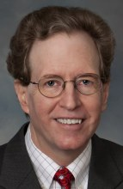
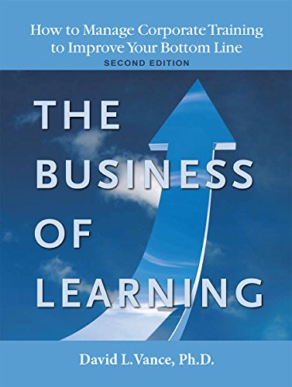

Your Facilitator
Executive Director, Center for Talent Reporting
Founder and Former President, Caterpillar University
  2005 1st Place in ATD BEST Awards
  2006 CLO of the Year
Former Chief Economist, Caterpillar Inc.
  Ph.D. in Economics
  Masters in Business Administration
Author, The Business of Learning (second edition) and Measurement Demystified with Peggy Parskey (2021, ATD Press)
Adjunct Professor in Human Capital Development
  Bellevue University (PhD program)
  University of Southern Mississippi (PhD program)
  George Mason University (Executive Education program)
Member, ISO Working Group on Metrics

Slide 4
The Center for Talent Reporting:
The Home of TDRp
Established October 2012
  Nonprofit, member-based professional association (like ATD)
Mission
  Improve and standardize the measurement, reporting, and management of human capital to deliver significant business value
Offerings
  Webinars
  Measurement and Reporting Workshops
  Coaching
  Annual conference
  Corporate memberships
  Certification and accreditation

Slide 5


Our Partners
We want to thank the following partners for their support of the Center for Talent Reporting.
PLATINUM PARTNER
Explorance is a Founding Partner

Slide 6


Our Partners
We want to thank the following partners for their support of the Center for Talent Reporting.
BRONZE PARTNERS
Bellevue University Human Capital Lab and ROI Institute are Founding Bronze Partners

Slide 7


Today’s Discussion
Review of the TDRp Framework
Review of Scorecards and Dashboards
Management Reports
The Three TDRp Reports to Manage Learning
Conclusion
Notes:
POLL #1: What is your HR Function (check all that apply)
Learning & Development
Leadership Development
Capability Development (career planning and progression)
Talent Acquisition
Other

Slide 8
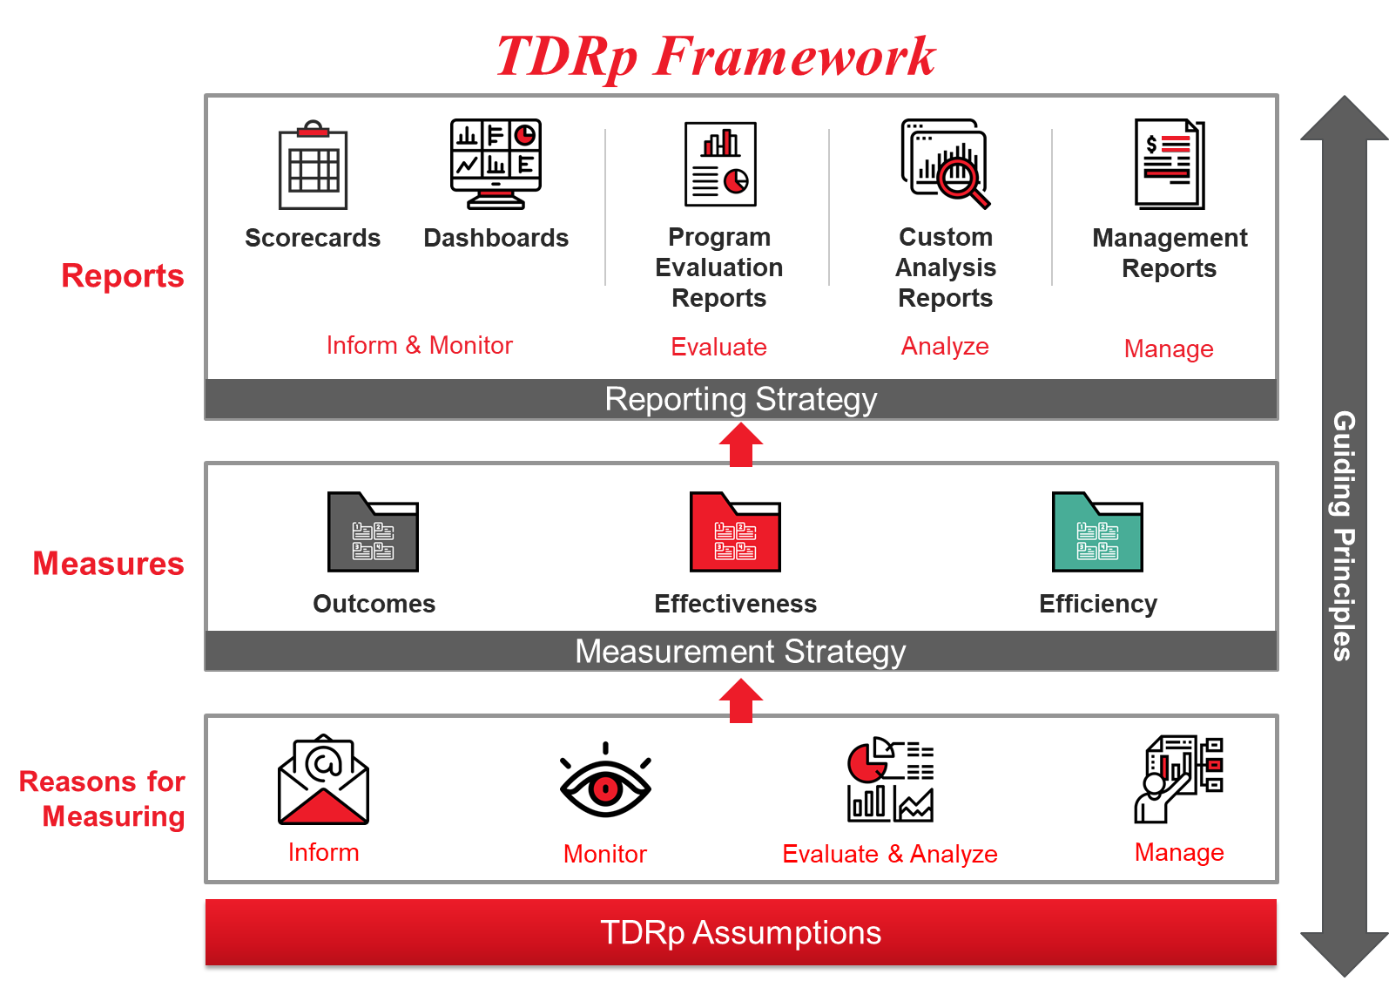

Slide 9
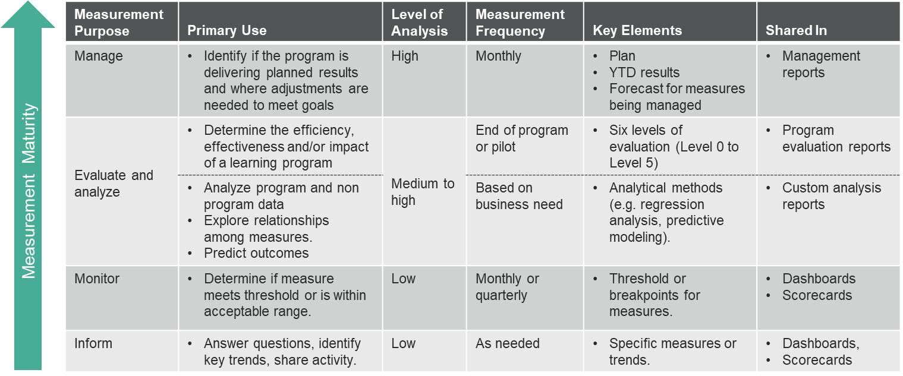
Measurement Requirements by Reason to Measure

Slide 10
Scorecards and Dashboards May be Used to Inform or Monitor

Slide 11

Scorecard Summary
Data in tabular form
  Typically, rows are the measures, columns are the time periods
Use scorecards to inform (or monitor)
  Show actual results by month, quarter, year-to-date, year
  May include a comparison to
    Prior month, quarter, year
    Threshold or Benchmark
Scorecards will always be
  Backwards looking
  Static

Slide 12
Example of a Typical Scorecard
Purpose: Inform

Slide 13
Scorecard for Monitoring
Purpose: Monitor

Slide 14
Dashboard Summary
Like the scorecard, a dashboard is used for informing or monitoring
Will contain a visual display and/or be interactive
  Speedometer, bar chart, line graph, pie charts
May contain a table but generally will have less data than a scorecard
  Often will have summary measures
May contain a threshold for monitoring
  Often will use color coding to denote status of measure

Slide 15
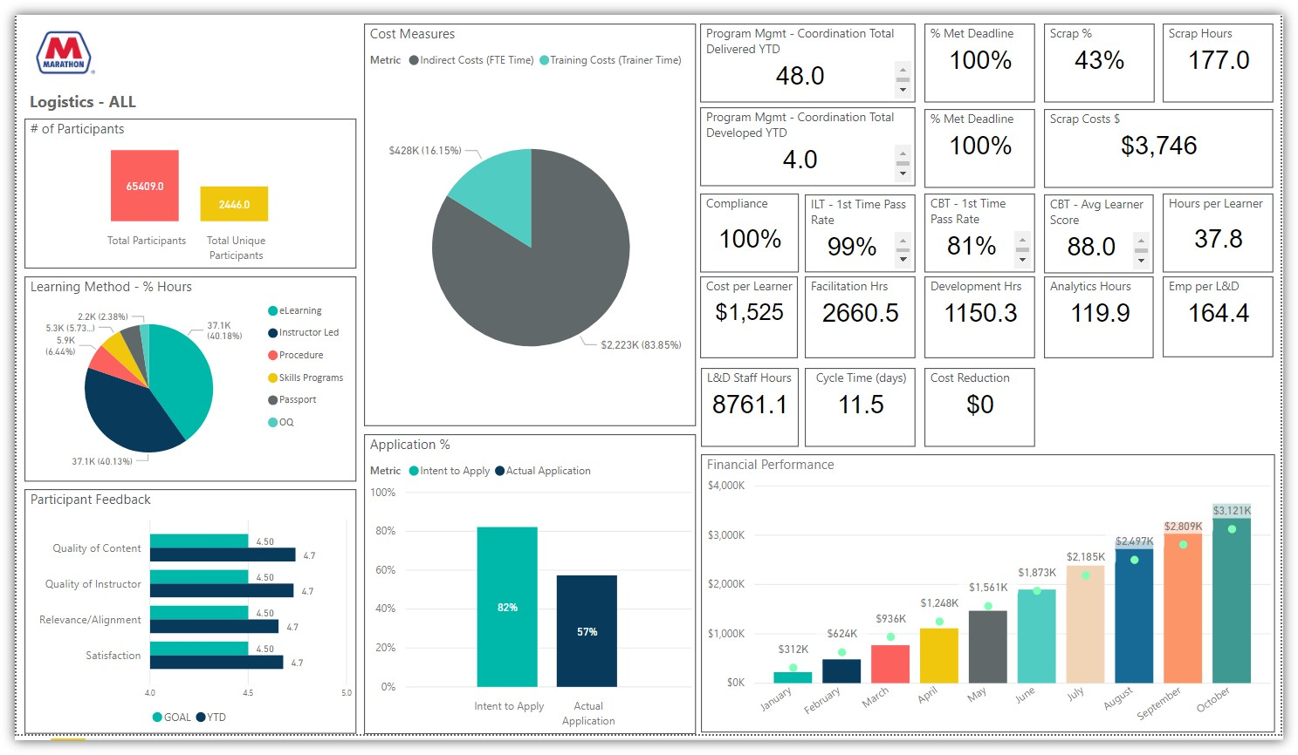
Dashboard Example from Marathon
Purpose: Inform

Slide 16
Management Reports

Slide 17
What Does It Mean to Run Learning Like a Business?
Create a plan with specific, measurable goals
  Targets or plan numbers for all key measures
    Efficiency measures
    Effectiveness measures
    Outcome measures if applicable
  Clarity of roles and responsibilities for all parties
Execute the plan with discipline
  Requires monthly management reports including
    Plan
    Year-to-date Results, YTD Results compared to Plan
    Forecast, Forecast compared to Plan

Slide 18
Management Reports
Generated at least monthly to actively manage the key measures of a program to successful conclusion
  Must answer two questions to ensure planned results are achieved
    Are we on plan?
    Will we end the year on plan?
  Will contain for each measure
    Plan
    Year-to-date results
    Comparison of YTD results to plan
    Forecast (optional)
    Comparison of forecast to plan (optional)
  Similar to reports used by sales and manufacturing

Slide 19
The Three TDRp Management Reports

Slide 20
The Three TDRp Management Reports
Operations Report
  Used by CLO to manage initiatives to improve
    Efficiency or effectiveness measures across the organization
    Efficiency or effectiveness of process and systems
Program Report
  Used by the program manager, goal owner and CLO to manage a program to successful conclusion
Summary Report
  Used by CLO to share information with CEO, CFO, governing board and L&D employees. Also to manage senior leader expectations and remove roadblocks
Standard format used for all three

Slide 21

Management Reports: To be Used in Monthly Meetings to Manage/Share Results
Department Head meeting with direct reports
  Ideally in a 1-2 hour meeting dedicated to managing results
  Cover Summary Report, Operations Report, Program Reports
  Take management action as necessary to deliver plan
Program Manager with team
  Use Program Report to manage program
  Prepare Program Report to be shared with Department Head
Other meetings (Senior Leaders, Board of Governors, CEO, employee meetings)
  Use Summary Report

Slide 22
The Three TDRp Management Reports

Slide 23



The Program Report
Purpose: Manage key programs to deliver planned results
Audience: Program Managers, CLO, Goal owner
Generated for each key goal or need supported by a major L&D program
  Includes measures necessary for senior talent leaders and managers to manage program, initiative, or process results on a monthly basis.
  Includes outcome or other success measures relevant to the program and the key effectiveness and efficiency measures.
Senior Talent Executives
Talent Development Program Report
Monthly
Outcomes
Effectiveness
Efficiency

Slide 24
Sample Program Report for L&D Programs in Support of the Goal to Reduce Injuries
Purpose: Manage programs

Slide 25
Sample Program Report for L&D
Programs in Support of the Goal to Reduce Injuries
Purpose: Manage programs

Slide 26
Program Report with “Headline Measures” of Success Rather than Outcome Measure
Purpose: Manage programs

Slide 27
Program Report with No Outcome or Headline Measures of Success
Purpose: Manage programs

Slide 28
Creating the Program Report
Discuss whether learning has a role to play with goal owner
If it does, agree on role, program specifics, an outcome measure and the key effectiveness and efficiency measures
Reach agreement with goal owner on plans for the outcome measure and the key effectiveness and efficiency measures
Fill in the top of the report with information on the goal, goal owner, outcome, and plans for the goal and outcome
Add the key effectiveness and efficiency measures for the programs in support of the goal. Add their units of measure
Fill in the plan for the effectiveness and efficiency measures
Set the forecast equal to the plan to start. Update as necessary
Add YTD results after the first month

Slide 29

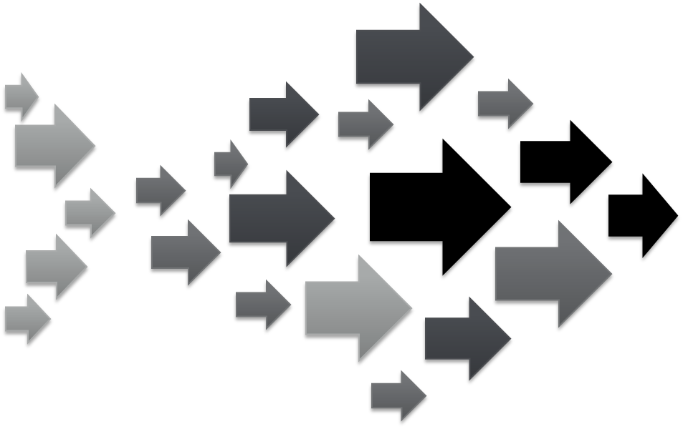


The Operations Report
Purpose: Manage Talent operations to deliver improvements in effectiveness and efficiency
Audience: CLO and managers
Covers two types of initiatives
  Improvements across all programs
  Improvements in department processes and informal learning
Operations Report
Effectiveness
Efficiency

Slide 30
Sample Operations Report for L&D
Purpose: Manage effectiveness and efficiency measures across all programs

Slide 31
Sample Operations Report for Informal Learning Initiatives

Slide 32
Sample Operations Report for Process Improvement Initiatives

Slide 33
Creating the Operations Report
Start with your lists of effectiveness and efficiency measures
Note those that will be managed. Confirm with Department Head
Place in the report. Order is up to you. Add unit of measure
Enter last year’s actuals if available
Enter plan for the current/coming year from the Department Head
Set the Forecast to plan to start. Update the forecast as necessary
After the first month’s results are in, begin to fill in the YTD column

Slide 34
Bringing it All Together: The Summary Report
Audience: Senior business and HR executives, CLO
  Most significant measures from the effectiveness, efficiency and outcome lists aggregated at the highest level
  Measures will vary by organization and year to year based on organizational priorities
Generated at least quarterly
Must be read holistically to obtain an accurate picture of progress against goals
Senior Business Executives
Talent Development Summary Report
Quarterly
Outcomes
Effectiveness
Efficiency

Slide 35
L&D Summary Report
Purpose: Manage and inform

Slide 36
L&D Summary Report (continued)

Slide 37
L&D Summary Report (continued)

Slide 38
Creating the Summary Report
Start by entering the organizational goal, goal owner, outcome measure, learning impact, units of measure, and plan goals from either your outcome measures list or your completed Program Reports
      These will be in the CEO’s priority order
Enter the key programs from the Program Reports in italics below the impact of learning (the outcome measure) for each goal
Enter two-four key effectiveness and efficiency measures, their units of measure, and their plans at the bottom
Add last year’s actuals for all measures where available
Set Forecast vales equal to plan to start. Update as necessary
Enter year-to-date information as it becomes available.

Slide 39
Conclusion

Slide 40
TDRP Designed to Meet Your Measurement and Reporting Needs
Simple, consistent approach
Use standard definitions to extract and convert data into three types of measures
Choose the appropriate measures depending on the learning
Use in scorecards, dashboards, program evaluation reports, custom analysis reports or management reports depending on their purpose
  Three management reports depending on what you want to manage
  Each will include plan, YTD results, and forecast for all key metrics

Slide 41
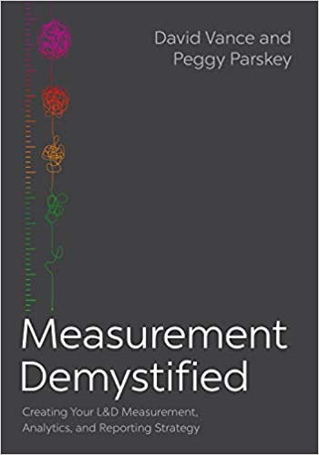

Learn More about Measurement & Reporting, TDRp
Measurement Demystified: Creating Your L&D Measurement, Analytics and Reporting Strategy (ATD Press, 2021)
  By David Vance and Peggy Parskey
  The definitive work on TDRp
Companion Measurement Demystified Field Guide (ATD Press, 2022) now available!
Get both on Amazon
  And a guide to reading both simultaneously at TD.org/MeasurementFieldGuide
DV

Slide 42
Measurement Demystified Workshop
Current open-enrollment virtual workshop is a series of seven modules
    September 8 & 20: TDRp framework, efficiency and effectiveness measures
    October 13 & 27: Effectiveness & outcome measures and selecting measures
    November 17, Dec 1 &15: Running learning like a business, reporting and strategy
$499 for all seven for CTR members ($799 nonmembers)
Special rate for alums! Only $399 for all three
And copy of our new books Measurement Demystified and Measurement Demystified Field Guide

Slide 43
2022 CTR Conference:
Ten-Year Anniversary of TDRp
Virtual
  November 2, 10-4 ET
Topics include
  History of measurement
  History and evolution of TDRp
  Current state of TDRp
  Lessons learned and unfinished business
  Future of measurement and reporting
Breakout sessions to discuss and share
Learn more and register at ctrconference.com

Slide 44
Ways to Accelerate Your Mastery
Webinars (Live and Recorded)
  TDRp Webinar Series for 2022
    Introduction to Measurement, Reporting, and TDR (4/13)
    Focus on Efficiency Measures (5/4)
    Focus on Effectiveness and Outcome Measures (6/8)
    Selecting Your Measures (7/20)
    Reporting & Running Learning Like a Business (8/10)
    The Three TDRp Management Reports (9/7)
    Creating Plan Numbers (10/12)
    Reporting YTD Results and Creating Forecasts (11/16)
    Creating Your Measurement & Reporting Strategy (12/14)
  Public Reporting: Are You Ready? (pending SEC announcement)
  Recorded Webinars
    Change Management for TDRp (Recorded)
    Senior Leaders (Recorded)
    Accounting Basics (Recorded)
    Financial Acumen Part 1 &2 (Recorded)
    Data Gathering Considerations (Recorded)
Virtual workshops
  Measurement Demystified
    First module tomorrow!
  Human Capital Reporting
    TBD
  Custom
    1, 2, or 3-day workshops
Virtual Coaching
Conference (virtual)
  November 2

Slide 45
Become a Member of the
Center for Talent Reporting
Benefits
  Access to Recordings and PPTs for all 20 webinars
  Access to Enhanced Content on the website
    Formulas and references for over 700 measures
    Excel versions of sample reports
    Detailed implementation guidance
    Members only page
    Business acumen resources
    Case studies
  Discount on workshops and conference
Investment: Only $299

Slide 46

Learn More about TDRP
Learn more and get implementation guidance at www.CenterforTalentReporting.org
  Introduction to TDRp whitepapers
  Over 700 measures (170 for L&D)
  More than 50 sample lists and reports
  Guidance on implementation
  Workshop, webinar and conference registration
Contact Dave Vance for more information: DVance@CenterforTalentReporting.org

