Slide 1
Creating Your Measurement and Reporting Strategy
#9 in the Nine-part Series
David Vance
Executive Director

Slide 2
Logistics for Today’s Webinar
  Link will be sent to all for PowerPoint and recording today
  To ask a question during the webinar, type a question in the Question box
We will take questions at the end, too
Members can access All PPTs and Recordings anytime on the website at Members Resource Center page.

Slide 3
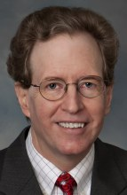
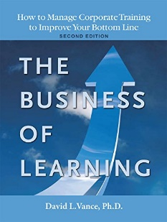


Your Facilitator
Executive Director, Center for Talent Reporting
Founder and Former President, Caterpillar University
  2005 1st Place in ATD BEST Awards
  2006 CLO of the Year
Former Chief Economist, Caterpillar Inc.
  Ph.D. in Economics, Masters in Business Administration
Author, The Business of Learning (second edition) and Measurement Demystified & Measurement Demystified Field Guide with Peggy Parskey (2021, 2022)
Adjunct Professor in Human Capital Development
  Bellevue University (PhD program)
  George Mason University (Executive Education program)
Member, ISO Working Group on Metrics

Slide 4
The Center for Talent Reporting:
The Home of TDRp
Established October 2012
  Nonprofit, member-based professional association (like ATD)
Mission
  Improve and standardize the measurement, reporting, and management of human capital to deliver significant business value
Offerings
  Webinars
  Measurement and Reporting Workshops
  Coaching
  Annual conference
  Corporate memberships
  Certification and accreditation

Slide 5



Our Partners
We want to thank the following partners for their support of the Center for Talent Reporting.
BRONZE PARTNERS
SUSTAINING PARTNER
All are Founding Partners

Slide 6
Review of First Eight Webinars
TDRp Framework (1)
Efficiency, Effectiveness and Outcome Measures (2 & 3)
How to Select Your Measures (4)
Reporting and Running Learning Like a Business (5)
Three TDRp Management Reports (6)
Creating Plans (7)
Reporting YTD Results and making Forecasts (8)

Slide 7


Agenda
Elements of a measurement and reporting strategy
Creating a measurement strategy
  Reasons for measuring and the users
  Selecting the measures
  Collecting the data
  Creating a measurement library
Creating a reporting strategy
Conclusion
Notes:
POLL #1: What is your HR Function (check all that apply)
Learning & Development
Leadership Development
Capability Development (career planning and progression)
Talent Acquisition
Other

Slide 8
Elements of a Measurement and Reporting Strategy

Slide 9
Elements of a Measurement and Reporting Strategy
Users and the reasons to measure
  Who are the users?
  Why do they want the measure?
The measures themselves
  Names
  Definitions
Plan for collecting the data and producing the measures
  What systems and processes are required?
  Which measures for which initiatives?
  Will sampling be used?
  Will there be a measures library?
The reports to be generated
  List by user
  Should match the reasons for measuring
Plan for producing the reports
  Frequency?
  Automated or manual process?
  Used in-person or emailed?
  Who is responsible?
Strategy may be word doc or PPT
See sample in Measurement Demystified Appendix C

Slide 10
Creating a Measurement Strategy:
Identify Users and the Reasons to Measure

Slide 11
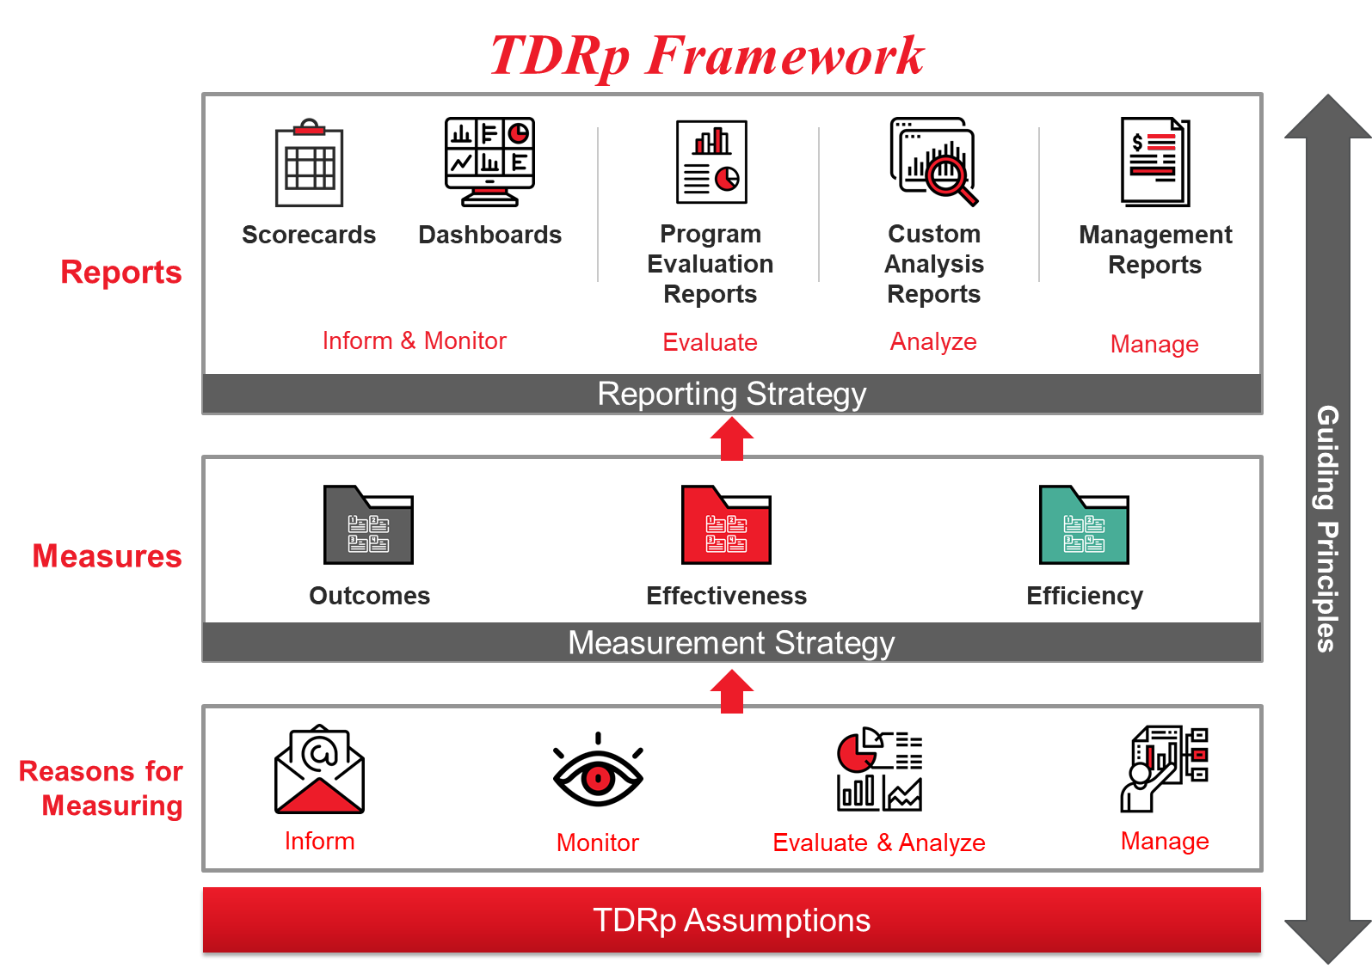

Slide 12
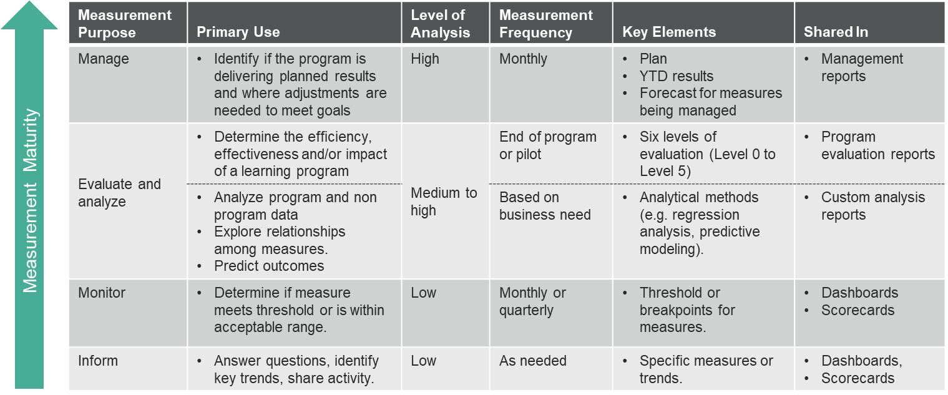
Measurement Requirements by Reason to Measure

Slide 13
The Foundation: Discussion with the User
Clarity is crucial
New requests for measures
  Ask the requester why they want the measure, how they plan to use it
  If they asked a for specific measure, is that what they really need?
  How often do they want to see it?
  If for monitoring, what are the thresholds?
  If for managing, what is the plan?
    For a program, also need plans for all key efficiency and effectiveness measures
  How do they want it shared?
    Emailed report, in-person briefing?
    Do they want history or any comparisons?

Slide 14
The Foundation: Discussion with the User (continued)
Existing users
  Did they ask for the report?
    If so, is it meeting their needs?
      Review their reasons for measuring
      Suggest alternative measures or reports as appropriate
    If not, do they find it useful?
      Yes: Ask them how they use it and why they find it helpful. Suggest alternatives if appropriate
      No: Stop producing the report for them. Are there other measures or reports which would be helpful?

Slide 15
Create a List of Users and Reasons for Measuring (might also include the requested measures)
From Measurement Demystified (ATD Press, 2021)

Slide 16
Creating a Measurement Strategy:
Select the Measures

Slide 17
A Good Measurement Strategy will Include All Three Types of Measures
Your list or matrix should include a good balance of efficiency and effectiveness measures
  Should also include an outcome measure whenever you are able to support a key goal like Increasing Sales or Reducing Injuries
Typical program measures include:
  Unique and total participants Completion rate
  Completion date Cost
  Participant reaction (level 1) Learning (level 2)
  Application rate (level 3) Impact (level 4)
  ROI (level 5)

Slide 18
A Good Measurement Strategy will Include All Three Types of Measures
Typical department level measures aggregated across all programs include
  Efficiency measures
    Unique and total participants Completion rate
    % on-time completions Cost
    Reach Number of courses, hours
  Effectiveness measures
    Participant reaction (level 1) Learning (level 2)
    Application rate (level 3) ROI (level 5) (list by program)
    Net benefit (level 5)
  Outcome measures
    Impact (level 4) (list by program)

Slide 19
Next, Create a List of Selected Measures
You need a record of selected measures by program so measurement analysts know exactly what needs to be collected
Several options
  By program
  By measure

Slide 20
Create a List of Measures
From Measurement Demystified (ATD Press, 2021)

Slide 21
A Measurement Matrix
From Measurement Demystified (ATD Press, 2021)

Slide 22
Creating a Measurement Strategy:
Collect the Data

Slide 23
Plan to Collect the Data
Once measures have been selected, create a plan for data collection
Identify the source for each measure
Also, if needed, the owner and arrangements to make the data available
  Is process automatic or manual?
  Date each month data are available
From Measurement Demystified (ATD Press, 2021)

Slide 24
Creating a Measurement Strategy:
Create a Measurement Library

Slide 25

Build a Measures Library
What is it? The single source of truth of your measures
  Based on TDRp measures library and consistent with standard industry definitions
  Can contain other measures relevant to your industry or company (particularly with respect to outcome measures)
Why is it important?
  Ensures a common language
  Creates accountability
  Builds maturity
What’s in it?
  The measure, type and definition
  Inform, evaluate, monitor or manage
  Criticality of the measure
  Frequency of data collection & availability (e.g. monthly, quarterly)
  Source of data (system captured, manual) and data owner (organization or individual)
  Ease of accessing the data (availability, security)
  Quality of the data
Who owns it? A standards body that maintains, updates and publishes the library

Slide 26

Building a Measures Library
Start with your measures list
  Populate the measures library with your measures
  Where possible, use the TDRp definitions
  Add information relevant to your organization
Rationalize your library against standards and industry best practices
  Determine if your suite of measures fully address the needs of the business and L&D
  Consider industry or functional best practices that may require specific measures

Slide 27
A Starter Measures Library
Columns Name | Source/explanation
HC Process | The process name in your organization
TDRp category | For reference with the TDRp categories (E, E, O)
Sub-category | Use the TDRp sub-category if possible
Measure name | Use the TDRp name if possible
Manage vs monitor | Flag measures that you will actively manage vs monitor
Definition | Use the TDRp name if possible
Computation | Use the TDRp formula if possible. If not, note it here
Reported today? | Yes or No
Data Source | System or person that generates this data
Criticality of measure | Importance of this measure to senior leaders
How Gathered | Manually, via a survey or an automated system
Ease of Collection | Easy, feasible, difficult
Comments/ other | Add other columns as necessary
Earlier you developed lists for effectiveness and efficiency measures
Your next steps is to gain agreement on the definitions (where possible, use the TDRp measures library as your starting point)
Customize the library to make it useful

Slide 28
Creating a Reporting Strategy

Slide 29
Reporting Strategy
The final component in your measurement and reporting strategy is the reporting
The type of report should already have been identified from your discussion with the user:
  Scorecard: Detailed data to inform or monitor
  Dashboard: Summary data often with visuals to inform or monitor
  Program evaluation report: Share results at end of pilot or program
  Custom analysis report: Share results of research at conclusion
  Management reports: Manage the measures to deliver planned results
    Program report: Multiple reports with each focused on an individual program
    Operations report: One report with aggregate data for the CLO
    Summary report: One report with aggregate data for CLO, CEO, CFO

Slide 30
Measurement Requirements by Reason to Measure

Slide 31
Example of a Typical Table or Scorecard
Purpose: Inform

Slide 32
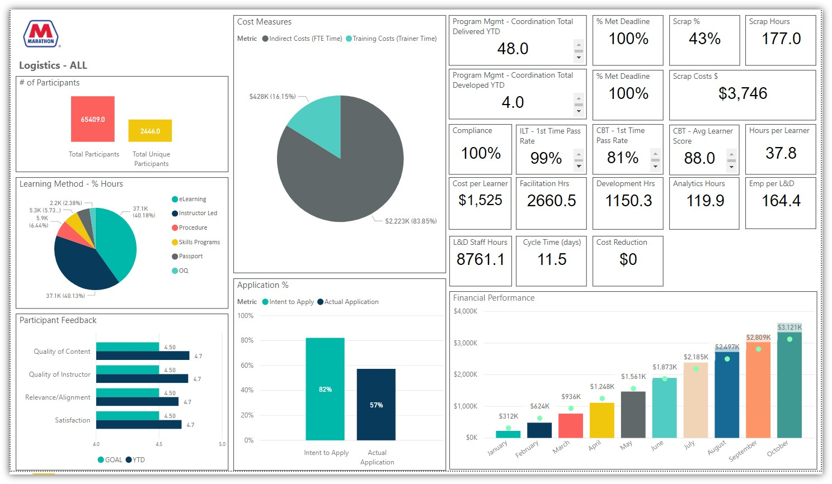
Dashboard Example from Marathon
Purpose: Inform

Slide 33
Example of a Departmental Dashboard
Purpose: Monitor

Slide 34
Example of a Simple Program Evaluation Report
The 2019 Sales Training Initiative
Goal was to help achieve the company goal of 10% higher sales
  Sales and learning departments agreed consultative selling skills and product features training should contribute to 3% higher sales
Extensive training and coaching provided to all 73 sales reps
  Consultative selling skills based on advice of most successful reps
  Expectations to sales reps clearly articulated by VP of Sales
  80 hours of training from January 1 – February 28
  Individual coaching and reinforcement by sales supervisors through June 30
  Monthly meetings between reps and supervisors to review progress
  Incentives for reps and supervisors revised to support the initiative
Effort completed on time and at budgeted cost of $325,000

Slide 35
Example of a Simple Program Evaluation Report (continued)
Training was well received and application rate was high
  90% agreed that the training was a worthwhile investment and would recommend it to others
  84% had applied key concepts and 100% had used the product features training after 90 days
Sample feedback
  “One of the best programs I have ever attended. The content was clear, powerful and relevant. Instructors were great and I really appreciated the coaching afterwards. This program allows me to increase my sales by at least 20%.”
  “I would strongly recommend this program to anyone who wants to dramatically improve their performance.”
With the help of this program, sales increased 11% for the year, exceeding plan of 10%

Slide 36
Example of a Simple Program Evaluation Report (continued)
The sales and learning departments believe that this initiative, including all the work by the sales supervisors to reinforce the learning and hold their reps accountable, contributed at least 3% higher sales resulting in an additional $585,000 in gross profit.
  Standard industry methodology used to isolate the impact of training which includes
    Adjusting for self-reported data
After subtracting the costs associated with the effort, including the time of the reps and supervisors, the initiative was responsible for $260,000 in net profit.
  The ROI is conservatively estimated at 80%
Lessons learned:
  Executive sponsorship and supervisor reinforcement are critical
  Further gains from learning are possible for 2018
  Participant feedback provided numerous ideas for improvement

Slide 37
Sample Program Report for L&D Programs in Support of the Goal to Reduce Injuries

Slide 38
Sample Operations Report for L&D
Purpose: Manage effectiveness and efficiency measures across all programs

Slide 39
L&D Summary Report
Purpose: Manage and inform

Slide 40
L&D Summary Report (continued)

Slide 41
L&D Summary Report (continued)

Slide 42
Create Report List by User
Need to create a list showing reports and users so everyone knows what reports will be generated for whom and with what frequency
Also, need to capture who will be responsible, how the reports will be distributed, and the date for distribution

Slide 43
Report List by User
From Measurement Demystified (ATD Press, 2021)

Slide 44
Expanded Report List with Additional Information

Slide 45
Conclusion

Slide 46
Advice
Department heads: Do not delegate responsibility of the measurement and reporting strategy to your staff. You need to own it and it needs to reflect your management strategy. You need to be clear how important it is: you must have the reports to manage.
Limit the number of measures and reports.
  Start with just a handful at each level. You can always add more later
Create a measure library which contains the essential information about all the measures
Create a measurement and reporting strategy document

Slide 47
Sample Table of Contents for a 17-page Plan (See Appendix C of Book for an Example)
Introduction………………………………………………...…….1
Reasons for measuring………………………………………....2
Users and their needs…………………………………………..3
Measures…………………………………………………………5
Reports…………………………………………………………..11
Data collection…………………………………………………..15
Resources……………………………………………………….17

Slide 48
Change Management Considerations
How big of a change (delta) is this?
What are likely sources of resistance?
  Are the L&D leaders on board?
What education is needed?
What communication is needed?
How will this benefit those in the department?

Slide 49
Learn More

Slide 50


Learn More about Measurement & Reporting, TDRp
Measurement Demystified: Creating Your L&D Measurement, Analytics and Reporting Strategy (ATD Press, 2021)
  By David Vance and Peggy Parskey
  The definitive work on TDRp
Companion Measurement Demystified Field Guide (ATD Press, 2022)
Get both on Amazon
  And a guide to reading both simultaneously at TD.org under Measurement Demystified
DV

Slide 51
Measurement Demystified Workshop
Current open-enrollment virtual workshop is a series of seven modules
    September 14 & 28: TDRp framework, efficiency and effectiveness measures
    October 12 & Nov 2: Effectiveness & outcome measures and selecting measures
    November 16 & 30: Running learning like a business, reporting and strategy
    December 14: Wrap Up
For all seven sessions: $479 enhanced, $599 basic, $799 nonmembers
Special rate for alums! Only $399
And copy of our new books Measurement Demystified and Measurement Demystified Field Guide

Slide 52
Implementing TDRP Virtual Workshop
November 7-8, 12-4 ET each day
Focus on implementation
  For each topic
    Brief review of the theory
    Share ideas and obstacles and solutions in small breakout groups
    Report out
  Topics include
    Assessing your readiness Getting buy-in
    Selecting program measures Selecting department measures
    Opportunities in your reporting Creating an implementation plan
    Overcoming obstacles
Registration now open

Slide 53
Want to Learn More about the New ISO Standard for L&D Metrics?
Join us October 25 from 10-2 CT for a workshop dedicated to
  In-depth understanding of the standard and its relationship to existing standards
  Exploration of the 52 recommended metrics by user and type
  Creation of an implementation plan
Registration now open at https://centerfortalentreporting.org/product/new-iso-standard-for-ld-metrics-workshop/
Limited to 20

Slide 54
Ways to Accelerate Your Mastery
Webinars
  TDRp Webinar Series
    Introduction to Measurement, Reporting, and TDR (10/11)
    Focus on Efficiency Measures (11/15)
    Focus on Effectiveness and Outcome Measures (12/6
    Selecting Your Measures Jan
    Reporting & Running Learning Like a Business Feb
    The Three TDRp Management Reports Mar
    Creating Plan Numbers Apr
    Reporting YTD Results and Creating Forecasts May
    Creating Your Measurement & Reporting Strategy Jun
  The New ISO Standard for L&D Metrics (TBD)
  Public Reporting: Are You Ready? (TBD)
Virtual workshops
  Measurement Demystified
    Sep-Dec: Registration now open
  The New ISO Standard on L&D Metrics
    October 25: Registration open
  Custom
    1, 2, or 3-day workshops
Virtual coaching
Public Workshop on Implementing TDRP
  November 7-8

Slide 55
Become a Member of the
Center for Talent Reporting
Basic Membership Benefits
  Access to Recordings and PPTs for all webinars
  Access to measures and reports libraries. View
    Formulas and references for over 700 measures
    Excel versions of sample reports
  25% discount on workshops
Investment: $299
Corporate memberships also available
Enhanced Membership Benefits
  All the benefits of basic membership
  Ability to download measures library
  Ability to download sample statements and reports in excel
  40% discount on workshops
  Two hours or coaching/consulting with Dave or Peggy
Investment: $599

Slide 56
Conclusion
  Link to PPT and Recording sent to all registrants later today
  All PPTs and Recordings available anytime to members at Member’s Resource Center page
  Contact Dave Vance DVance@CenterforTalentReporting.org with any questions about the recordings or PowerPoints
Questions?

