Slide 1
Focus on Efficiency Measures
#2 in the Nine-part Series
David Vance
Executive Director

Slide 2
Logistics for Today’s Webinar
  PowerPoint and link to recording sent later today
  To ask a question during the webinar, type a question in Chat
We will take questions at the end, too
Members can access All PPTs and Recordings anytime on the website at Members Resource Center page.

Slide 3
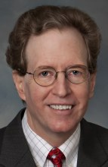
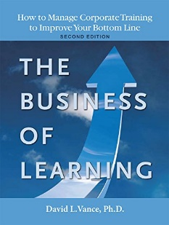


Your Facilitator
Executive Director, Center for Talent Reporting
Founder and Former President, Caterpillar University
  2005 1st Place in ATD BEST Awards
  2006 CLO of the Year
Former Chief Economist, Caterpillar Inc.
  Ph.D. in Economics, Masters in Business Administration
Author, The Business of Learning (second edition), and Measurement Demystified (2021) & Measurement Demystified Field Guide (2022) with Peggy Parskey (ATD Press)
Adjunct Professor in Human Capital Development
  Bellevue University (PhD program)
  George Mason University (Executive Education program)
Member, ISO Working Group on Metrics

Slide 4
The Center for Talent Reporting:
The Home of TDRp
Established October 2012
  Nonprofit, member-based professional association (like ATD)
Mission
  Improve and standardize the measurement, reporting, and management of human capital to deliver significant business value
Offerings
  Webinars
  Measurement and Reporting Workshops
  ISO Workshops
  Coaching
  Corporate memberships

Slide 5


Our Partners
We want to thank the following partners for their support of the Center for Talent Reporting.
BRONZE PARTNERS
Bellevue University Human Capital Lab and ROI Institute are Founding Bronze Partners

Slide 6


Today’s Discussion
TDRp Framework
Efficiency Measures for L&D
Benchmarking & Recommendations
Conclusion
Notes:
POLL #1: What is your HR Function (check all that apply)
Learning & Development
Leadership Development
Capability Development (career planning and progression)
Talent Acquisition
Other

Slide 7
TDRp Framework

Slide 8
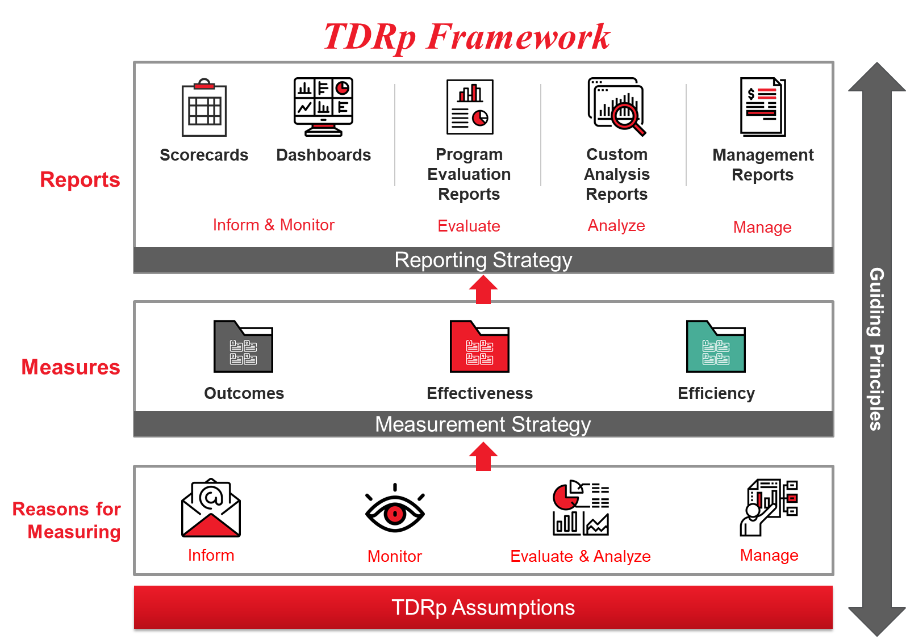

Slide 9
The Three Types of TDRp Measures
Efficiency: quantity, volume, utilization or cost of program or initiative
  For individual programs and for enterprise overall
  Examples: Number of participants, courses, hours; cost, completion dates, utilization rates, cycle times
Effectiveness: quality of program or initiative
  For individual programs and for enterprise overall
  Examples: Participant satisfaction with training, goal owner satisfaction, learning, application, reinforcement, supervisor support, ROI
Outcomes: impact of learning initiatives on organizational goals
  Will be a different set for each organization because goals and initiatives are different.
  Common outcome measures are impact of learning on: sales, cost, quality, employee engagement, leadership score, and customer satisfaction

Slide 10
Efficiency Measures
Process | Efficiency Measures
Learning & Development | Number of participants, courses; utilization rate
Talent Acquisition | Number of internal/external hires, acceptance rate, time to start
Leadership Development | Span of control, tenure, % of positions filled internally
Performance Management | Number of performance discussions, % of employees with goals, % of employees with performance reviews
Capability Management | Number of promotions, number of transfers, average time in position
Total Rewards | Average benefit cost, variable compensation %

Slide 11
Efficiency Measures for L&D

Slide 12
Efficiency Measures
In L&D, most of our measures are efficiency measures
  About 150 of the 170 L&D measures in the CTR library
Many efficiency measures are foundational
  Have been in use for years
  Some should be included in any measurement strategy

Slide 13
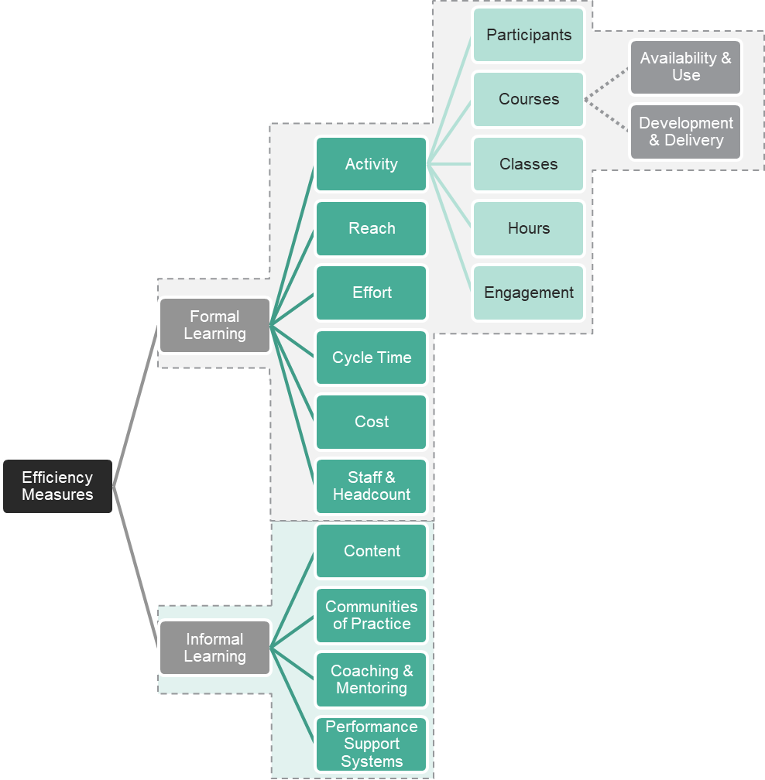
Taxonomy of Efficiency Measures
From Measurement Demystified, ATD 2021

Slide 14
Efficiency Measures
Sometimes an efficiency measure by itself will tell you about efficiency which is usually a measure of output per input.
  Examples would be
    Utilization rate for classrooms, instructors, courses
      Defined as number utilized / total available
    Percentage meeting deadline for courses developed or delivered
      Defined as number meeting deadline / total developed or delivered
    Reach
      Defined as number of employees who took at least one course / total number of employees
  In all of these cases, generally a higher % indicates greater efficiency

Slide 15
Efficiency Measures
For other efficiency measures, one efficiency measure may be divided by another, or may be compared to benchmark, history or plan to make a statement about efficiency.
  Examples of one measure divided by another
    Expenditures per participant, cost per course, hours per employee
  Examples where the measure is often compared to a benchmark or industry average
    Expenditures per participant, cost per course, hours of learning per employee
    ATD, others provide industry averages and benchmarks
  Examples where measure is compared to plan or history
    Number of participants, cost of development, time required for development

Slide 16

Total vs Unique Participants
Total participants
  Reflects the volume of training delivered
  Informs financial, human, technology and physical resource requirements
Unique participants
  Reflects the number of individuals impacted by training
  Provides an indicator of the degree to which you are reaching your target audience
Considerations
  Total participants: easy to compute
  Unique participants: requires a little more thought (must delete overlaps)

Slide 17
Participants

Slide 18
Courses
Availability and Use Measures

Slide 19
Courses
Development and Delivery Measures

Slide 20
Class Measures

Slide 21
Hour Measures

Slide 22
Hour Measures continued

Slide 23
Engagement

Slide 24
Reach Measures

Slide 25
Effort Measures
Measuring the time required

Slide 26
Cycle Time Measures
Measuring the duration of a process

Slide 27
Cost Measures
Direct expenditure (or cost) is the most common cost measure
It excludes learner’s travel expenses and opportunity costs (the value of the participant’s time which equals their labor & related cost)

Slide 28
Cost Measures continued

Slide 29
Learning Staff and Employee Headcount

Slide 30
Minimum Recommended Efficiency Measures for Formal Learning
For programs
  Unique participants
  Total participants
  Completion date
  Completion rate
  Direct expenditure
For the Department
  Unique participants
  Total participants
  Percentage on-time completions
  Direct expenditure
  Number of courses, hours by modality
  Reach

Slide 31
Informal Learning Measures
Four categories
  Content
  Knowledge Sharing (Communities of Practice)
  Coaching and Mentoring
  Performance Support
General types of measures
  Participants
  Usage
  Time spent

Slide 32
Content

Slide 33
Content (continued)

Slide 34
Communities of Practice

Slide 35
Coaching and Mentoring

Slide 36
Performance Support

Slide 37
ATD Benchmarking
Annual benchmarking available through the State of Industry Report for 13 measures
    Learning hours used per employee
    Learning hours available per L&D staff member
    Learning hours used per L&D staff member
    Percentage unique hours available by delivery type
    Percentage total hours used by delivery type
    Direct expenditure per employee
    Direct expenditure as a percentage of revenue
    Direct expenditure as a percentage of payroll
    Percentage of direct expenditure for tuition reimbursement
    Percentage of direct expenditure for external services
    Cost per learning hour available
    Cost per learning hour used
    Employees per L&D staff member

Slide 38
ISO Recommendations
ISO 30414:2018 Human Capital Reporting recommends seven efficiency measures for large organizations
  Formal training hours per employee
  Total development and training cost (for public sharing)
  Five measures for reach
    Percentage of employees who participate in training
    Percentage of employees who participate in formalized training by category of training
    Percentage of leaders who participate in training
    Percentage of leaders who participate in leadership development
    Percentage of employees who complete training on compliance and ethics

Slide 39
Relationship of ISO and TDRp Measures

Slide 40
ISO Recommendations (continued)
ISO TS 30428:2021 Human resource management – Skills and capabilities metrics cluster
  Detailed descriptions for five of the seven efficiency metrics in ISO 30414
    Total development and training cost
    Formal training hours per employee
    Percentage of employees who participate in training
    Percentage of employees who participate in formalized training by category of training
    Percentage of employees who complete training on compliance and ethics

Slide 41
ISO Recommendations (continued)TS30437 Highlights
TS30437:2023 Human Resources Management - L&D Metrics
  52 metrics recommendations for large organizations
  19 metrics recommended for small/medium organizations
  Recommendations made by type of user and type of metric
    For example, eight effectiveness metrics for the head of learning for a large organization
  Recommendations also made for formal and informal learning metrics
  Definitions provided for all 52 metrics
    Examples of use in a table provided for many
  Sample reports using the recommended metrics

Slide 42
Efficiency Measures

Slide 43
Efficiency Measures (continued)

Slide 44
Conclusion
Notes:
What is your level of experience in providing executive reports to senior leaders?
Significant experience
Moderate experience
Some experience
No experience

Slide 45
Summary
There are about 150 efficiency measures for L&D. These are grouped into subcategories like participants, courses, reach, and cost for formal learning
  13 are benchmarkable by ATD annually
  52 are described in ISO 30437
  5 are described in detail in ISO 30428
  100 are covered in our book Measurement Demystified
For informal learning, we focused on four categories
  Content
  Communities of practice
  Coaching and mentoring
  Performance support

Slide 46


Learn More about Measurement & Reporting, TDRp
Measurement Demystified: Creating Your L&D Measurement, Analytics and Reporting Strategy (ATD Press, 2021)
  By David Vance and Peggy Parskey
  The definitive work on TDRp
Companion Measurement Demystified Field Guide (ATD Press, 2022)
Get both on Amazon
  And a guide to reading both simultaneously at TD.org under Measurement Demystified
DV

Slide 47
Ways to Accelerate Your Mastery
Webinars
  TDRp Webinar Series
    Introduction to Measurement, Reporting, and TDR (10/11)
    Focus on Efficiency Measures (11/15)
    Focus on Effectiveness and Outcome Measures (12/6)
    Selecting Your Measures (Jan 17)
    Reporting & Running Learning Like a Business (Feb 14)
    The Three TDRp Management Reports (Mar 13)
    Creating Plan Numbers (Apr 17)
    Reporting YTD Results and Creating Forecasts (May 15)
    Creating Your Measurement & Reporting Strategy (Jun 20)
  The New ISO Standard for L&D Metrics (TBD)
  Public Reporting: Are You Ready? (TBD)
Virtual workshops
  Measurement Demystified
    Feb – May 2024: Registration open soon
  The New ISO Standard on L&D Metrics
    February 15 (tentative): Registration open soon
  Custom
    1, 2, or 3-day workshops
Virtual coaching

Slide 48
Measurement Demystified Workshop
The virtual workshop is a series of six modules (two each month)
    March (Feb 29): TDRp framework, efficiency and effectiveness measures
    April: Effectiveness & outcome measures and selecting measures
    May: Running learning like a business and reporting
    Each has homework
And copy of our new books Measurement Demystified and Measurement Demystified The Field Guide

Slide 49
Become a Member of the
Center for Talent Reporting
Basic Membership Benefits
  Access to Recordings and PPTs for all webinars
  Access to measures and reports libraries. View
    Formulas and references for over 700 measures
    Excel versions of sample reports
  25% discount on workshops
Investment: $299
Corporate memberships also available
Enhanced Membership Benefits
  All the benefits of basic membership
  Ability to download measures library
  Ability to download sample statements and reports in excel
  40% discount on workshops
  Two hours or coaching/consulting with Dave or Peggy
Investment: $599

Slide 50

Learn More about TDRP
Learn more and get implementation guidance at www.CenterforTalentReporting.org
  Introduction to TDRp whitepapers
  Over 700 measures (170 for L&D)
  More than 50 sample lists, statements and reports
  Guidance on implementation
  Workshop, webinar and conference registration

Slide 51
Conclusion
  Link to PPT and Recording sent to all registrants within 24 hours
  All PPTs and Recordings available anytime to members at Member’s Resource Center page
Contact for more information:
  Dave Vance: DVance@CenterforTalentReporting.org
  Peggy Parskey: PParskey@CenterforTalentReporting.org
Questions?
Questions?

