Slide 1
Introduction to Measurement, Reporting, and the TDRp Framework and the new ISO Standard for L&D Metrics
#1 in the Nine-part Series
#1
David Vance
Executive Director

Slide 2
Logistics for Today’s Webinar
  PowerPoint and link to recording sent later today
  To ask a question during the webinar, type a question in Chat
We will take questions at the end, too
Members can access All PPTs and Recordings anytime on the website at Members Resource Center page.

Slide 3
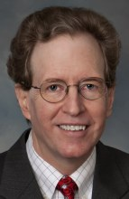
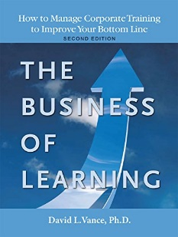


Your Facilitator
Executive Director, Center for Talent Reporting
Founder and Former President, Caterpillar University
  2005 1st Place in ATD BEST Awards
  2006 CLO of the Year
Former Chief Economist, Caterpillar Inc.
  Ph.D. in Economics, Masters in Business Administration
Author, The Business of Learning (second edition), and Measurement Demystified (2021) & Measurement Demystified Field Guide (2022) with Peggy Parskey (ATD Press)
Adjunct Professor in Human Capital Development
  Bellevue University (PhD program)
  George Mason University (Executive Education program)
Member, ISO Working Group on Metrics

Slide 4
The Center for Talent Reporting:
The Home of TDRp
Established October 2012
  Nonprofit, member-based professional association (like ATD)
Mission
  Improve and standardize the measurement, reporting, and management of human capital to deliver significant business value
Offerings
  Webinars
  Measurement and Reporting Workshops
  ISO Workshops
  Coaching
  Corporate memberships

Slide 5



Our Partners
We want to thank the following partners for their support of the Center for Talent Reporting.
BRONZE PARTNERS
SUSTAINING PARTNER
All are Founding Partners

Slide 6


Today’s Discussion
Why Have a Measurement and Reporting Strategy?
The Nine-part Series
TDRp Framework
Reasons to Measure
Three Types of Measures
Five Types of Reports
Recent Events in Human Capital Reporting
Conclusion
Notes:
POLL #1: What is your HR Function (check all that apply)
Learning & Development
Leadership Development
Capability Development (career planning and progression)
Talent Acquisition
Other

Slide 7
Why Have a Measurement and Reporting Strategy?

Slide 8
The Benefits of a Measurement and Reporting Strategy
A disciplined approach to answer questions about your activities and program value
  Prove your worth
  Make a stronger case for budget and staff
Allows you to run learning like a business to deliver greater value
Identify opportunities for continuous improvement
Helps you become a better business partner and speak the language of business

Slide 9
The Nine-part Series

Slide 10
TDRP Nine-part Series
Introduction to Measurement, Reporting and TDRp
Focus on Efficiency Measures (Nov)
Focus on Effectiveness and Outcome Measures (Dec)
Selecting the Right Measures (Jan)
Reporting and Running Learning Like a Business (Feb)
The Three TDRp Management Reports (Mar)
Creating Plan Numbers (Apr)
Using YTD Estimates and Making Forecasts (May)
Creating Your Measurement and Reporting Strategy (Jun)

Slide 11
TDRp Framework

Slide 12
Frameworks Are Helpful
Frameworks provide a common language and make communication easier
Example: GAAP for accountants
  Four types of measures
  Three types of statements
Other professions have frameworks, classifications or taxonomies
Frameworks in L&D
  Talent Development Reporting principles (TDRp)
  Kirkpatrick and Phillips also have provided frameworks for program evaluation
  Both have been incorporated in TDRp for L&D

Slide 13
Talent Development Reporting Principles (TDRp)
Brings principles, standards, definitions and recommended reports to L&D
Also brings standard management practices to L&D
Answers the common questions
  What types of measures should I use?
  What should I do with them once I have them?
Engaged 30 industry thought leaders like Fitz-enz, Bassi, Phillips, Brinkerhoff, Bersin and CLOs/ Senior Talent Leaders of major organizations in 2010-2011

Slide 14
Talent Development Reporting Principles (TDRp) continued
Built out for six key HR processes
  L&D Leadership Development Talent Acquisition
  Total Rewards Performance Management Capability Management

Slide 15
What TDRp Offers
Four broad reasons to measure
Classification of measures into three types
Five types of reports
  Three customizable management reports
Standard names and definitions for measures
Guidance for
  Choosing the right measures
  Aligning your programs to organization goals
  Reaching agreement on planned impact on organizational goals
  Setting plans for effectiveness and efficiency measures at department level
  Creating and using reports to manage

Slide 16
Common Language and Framework
Use four broad reasons to measure
Adopt three types of measures
  Effectiveness measures: quality
  Efficiency measures: quantity, cost, utilization
  Outcome measures: impact on the business (organization)
Select your measures based on reason to measure
  Have a balance
  You will always have efficiency and effectiveness measures
Use all five types of reports

Slide 17
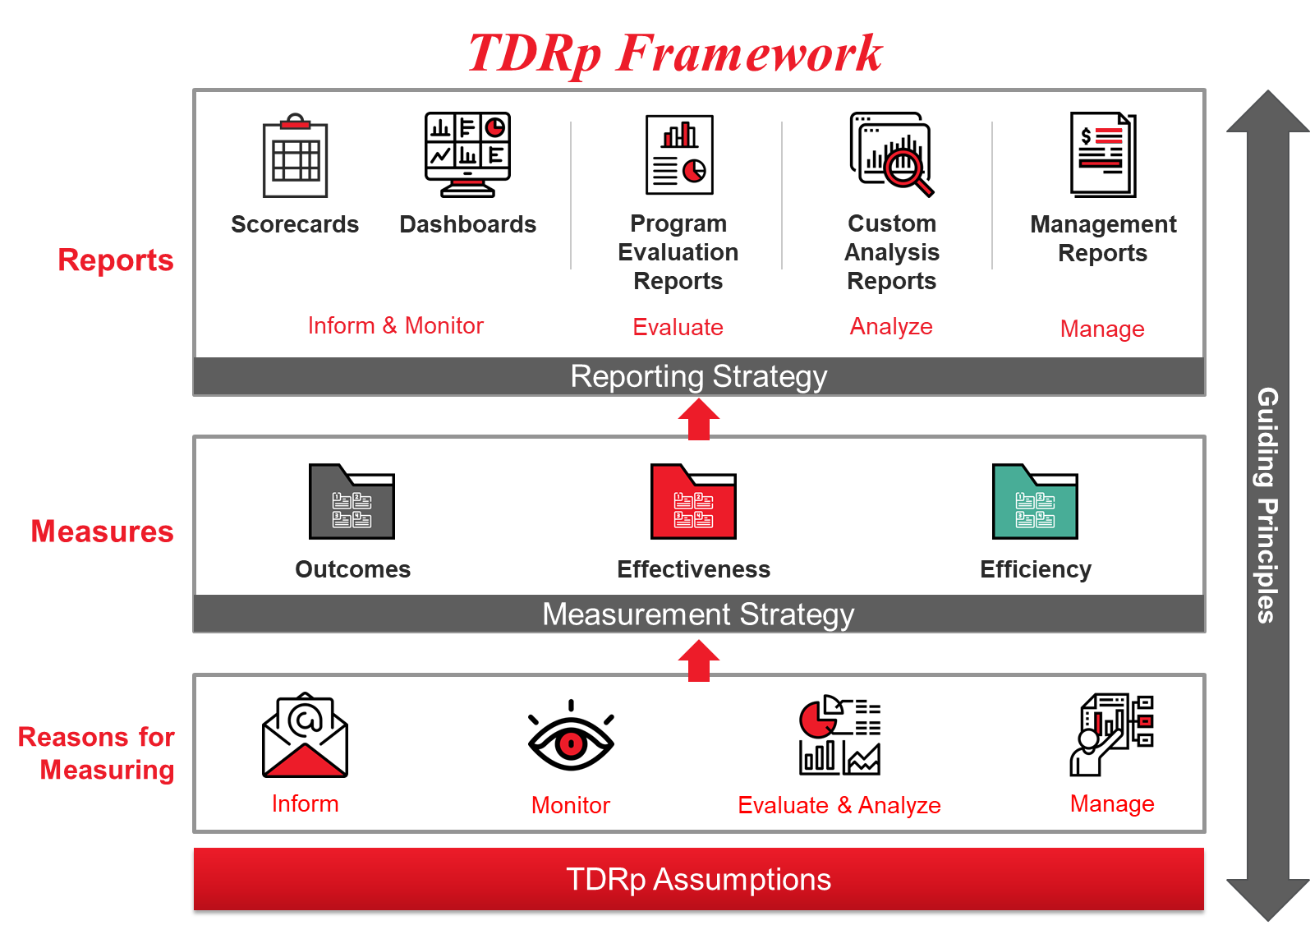

Slide 18
Reasons to Measure

Slide 19
Why Do We Measure?
Answer questions. Provide summaries of activity
Share our results with others
Identify trends
Evaluate a program and identify opportunities for improvement
Demonstrate our value
Manage programs and the department to achieve a plan or improve

Slide 20
Reasons to Measure
Could we think of these as high-level categories?
  Inform
    Answer Qs about activity, identify trends
  Monitor
    Determine if measure is in line with historical expectations
  Evaluate & Analyze
    Determine the efficiency, effectiveness, and impact of a program. Identify opportunities for improvement
  Manage
    Plan to reach new goals, execute, make decisions
What is the focus for most measurement efforts?

Slide 21
Measurement Hierarchy

Slide 22
The Three Types of TDRp Measures

Slide 23
The Three Types of TDRp Measures
Efficiency: quantity, volume, utilization or cost of program or initiative
  For individual programs and for enterprise overall
  Examples: Number of participants, courses, hours; cost, completion dates, utilization rates, cycle times
Effectiveness: quality of program or initiative
  For individual programs and for enterprise overall
  Examples: Participant reaction, goal owner satisfaction, learning, application, reinforcement, supervisor support, ROI
Outcomes: impact of learning initiatives on organizational goals
  Will be a different set for each organization because goals and initiatives are different.
  Common outcome measures are impact of learning on: sales, cost, quality, employee engagement, leadership score, and customer satisfaction

Slide 24
Efficiency Measures
Process | Efficiency Measures
Learning & Development | Number of participants, courses; utilization rate
Talent Acquisition | Number of internal/external hires, acceptance rate, time to start
Leadership Development | Span of control, tenure, % of positions filled internally
Performance Management | Number of performance discussions, % of employees with goals, % of employees with performance reviews
Capability Management | Number of promotions, number of transfers, average time in position
Total Rewards | Average benefit cost, variable compensation %

Slide 25
Effectiveness Measures
Process | Effectiveness Measures
Learning & Development | Reaction, learning, application, impact, ROI
Talent Acquisition | Quality of hire, hiring process effectiveness
Leadership Development | Bench strength, Succession planning success rate
Performance Management | % of employees with improved ratings, % of employees with rating turnaround
Capability Management | % of employees with career discussion, % career movement, % of positions with ready replacement
Total Rewards | High performers salary differential, compa ratio

Slide 26
Most Common Outcome Measures
Impact of learning on sales, revenue, or budget
Impact of learning on productivity, quality or efficiency
Impact of learning on customer, patient, or student satisfaction
Impact of learning on accidents or injuries
Impact of learning on number of customers, students, market share
Impact of learning on employee engagement
Impact of learning on leadership score on employee engagement survey

Slide 27
Categorize Your Measures by Type
How would you categorize your measures by type?
Are some hard to categorize?
Do you have a balance?

Slide 28
Reporting

Slide 29
Reports Are the Connection Between Measures and the Users
The critical role of reports
  Measures => Reports => User
Reports should be designed to provide the user with the information they want
  Single piece of information probably does not require a report
  Multiple data elements generally will
  Written report or PPT may be preferred over a table or in addition

Slide 30
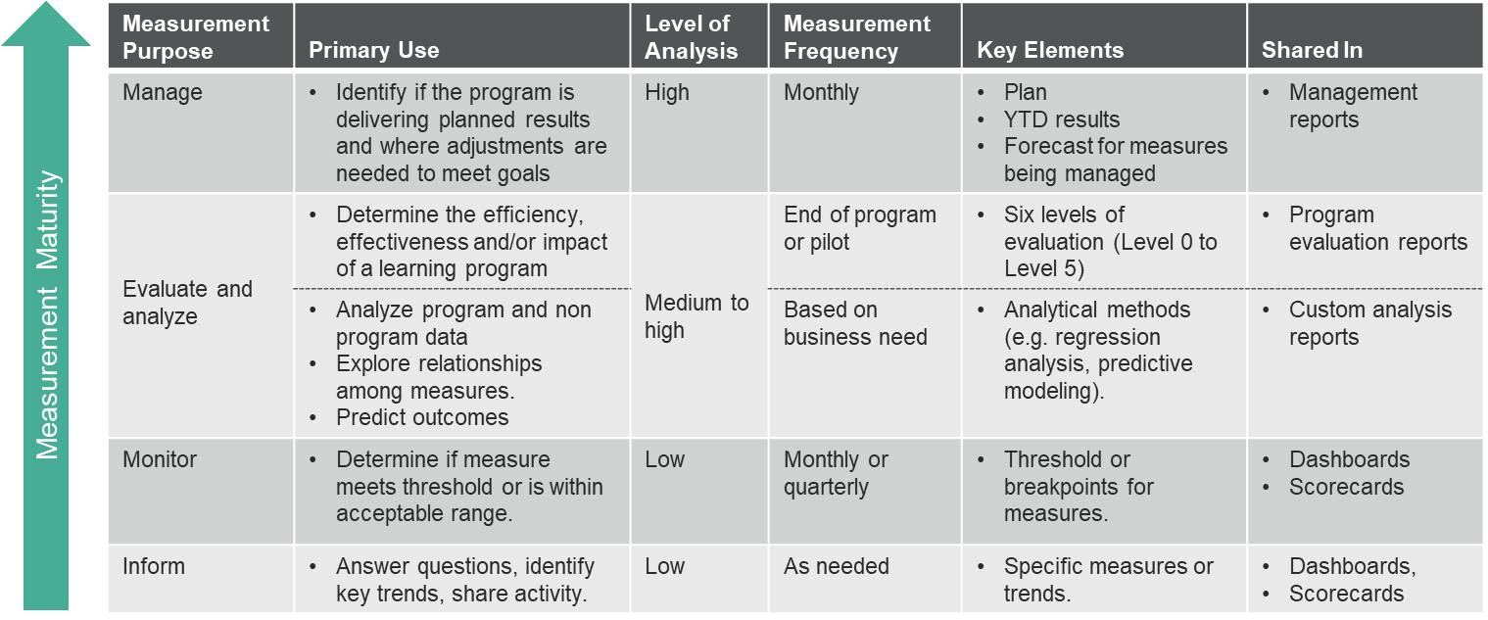
Measurement Requirements by Reason to Measure

Slide 31
Different Types of Reports
Scorecard or Dashboard to inform or monitor
  Many varieties. Some include a visual display
  Typically shows only historical data
  Frequency of data may be monthly, quarterly or annual
  May also contain year-to-date (YTD) information
  Good for sharing history and identifying trends
Program Evaluation Report to share evaluation results
  A one-off report to share results at the end of a program
    Many varieties. May be PPT or text
  Excellent for project wrap up, identifying opportunities for improvement

Slide 32
Different Types of Reports
Custom Analysis Report to share analysis results
  A one-off report to share results at the end of a research project
    Many varieties. May be PPT or text
Reports to manage
  Shows plan and progress compared to plan
    Use a forecast to determine if you are on track to make plan
  Three types
    Operations report to manage department improvement initiatives
    Program report to manage strategic and non-strategic programs
    Summary report to share with senior leaders

Slide 33
The Complete TDRp Framework

Slide 34
TDRP Designed to Meet Your Measurement and Reporting Needs
Simple, consistent approach with a common language
Start with the reasons to measure. Know your users
Use standard definitions to extract and convert data into three types of measures
Use in scorecards, dashboards, program evaluation reports, custom analysis reports, or management reports depending on their purpose

Slide 35
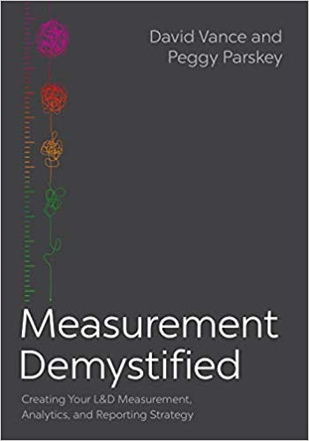

Learn More about Measurement & Reporting, TDRp
Measurement Demystified: Creating Your L&D Measurement, Analytics and Reporting Strategy (ATD Press, 2021)
  By David Vance and Peggy Parskey
  The definitive work on TDRp
Companion Measurement Demystified Field Guide (ATD Press, 2022)
Get both on Amazon
  And a guide to reading both simultaneously at TD.org under Measurement Demystified
DV

Slide 36
Ways to Accelerate Your Mastery
Webinars
  TDRp Webinar Series
    Introduction to Measurement, Reporting, and TDR (10/11)
    Focus on Efficiency Measures (11/15)
    Focus on Effectiveness and Outcome Measures (12/6)
    Selecting Your Measures (Jan)
    Reporting & Running Learning Like a Business (Feb)
    The Three TDRp Management Reports (Mar)
    Creating Plan Numbers (Apr)
    Reporting YTD Results and Creating Forecasts (May)
    Creating Your Measurement & Reporting Strategy (Jun)
  The New ISO Standard for L&D Metrics (TBD)
  Public Reporting: Are You Ready? (TBD)
Virtual workshops
  Measurement Demystified
    Sep – Dec: Ongoing
  The New ISO Standard on L&D Metrics
    October 25: Registration open
  Custom
    1, 2, or 3-day workshops
Virtual coaching

Slide 37

Learn More about TDRP
Learn more and get implementation guidance at www.CenterforTalentReporting.org
  Introduction to TDRp whitepapers
  Over 700 measures (170 for L&D)
  More than 50 sample lists, statements and reports
  Guidance on implementation
  Workshop, webinar and conference registration
Contact Dave Vance for more information: DVance@CenterforTalentReporting.org

Slide 38
The New Standard on L&D Metrics and Related Standards

Slide 39
The New ISO Standard on L&D Metrics
ISO TS 30437 Human resource development – Learning and development metrics is the name of the standard
  The “TS” denotes a Technical Specification which will be reviewed every three years
  “30437” is the number of this standard
Created to support ISO 30422 – Human resource management – Learning and development published in 2022
The result of two years work by ISO Technical Committee (TC) 260 on Human Resource Development, Working Group 2 Metrics
  Members from many countries including US, Canada, UK, and Australia
  With input from Germany and France

Slide 40
Relationship to Other Related ISO Standards
ISO 30414:2018 Human resource management — Guidelines for internal and external human capital reporting
  Contains 60 metrics for human capital reporting
  Recommends 23 for public disclosure by large organizations
  Recommends10 for public disclosure by small/medium-sized organizations
  Includes seven related to L&D
    Public disclosure: Cost, Percentage of ee’s who have completed training on compliance and ethics
ISO TS 30428:2021 Human resource management – Skills and capabilities metrics cluster
  In-depth discussion of five L&D metrics from 30414, including cost
ISO 30437 includes all the L&D-related metrics from 30414

Slide 41
New Standard Designed to Provide Much Needed International Guidance
The need
  Explain how to create a measurement and reporting strategy for L&D metrics
  Classification framework for measures and reports
  Names, definitions and formulas for metrics
  Starting list of metrics for consideration
The benefit
  Move toward a common language and framework
  Should make it easier to select, define and calculate appropriate L&D metrics
  Provide guidance on sharing the metrics
  Improve quality of benchmarking

Slide 42
ISO TS30437 Highlights
52 metrics recommended for large organizations
19 metrics recommended for small/medium organizations
Recommendations made by type of user and type of metric
  For example, eight effectiveness metrics for the head of learning for a large organization
Recommendations also made for formal and informal learning metrics
Definitions provided for all 52 metrics
  Examples of use in a table provided for many
Sample reports using the recommended metrics

Slide 43
ISO TS30437 Key Components
The framework
  Five categories of users
  Four broad reasons to measure
  Three types of measures
  Four types of reports
Recommendation of metrics by user, type of metric, and size of organization
Definitions and formulas with examples of usage
Sample reports using the recommend metrics

Slide 44
Framework
Four reasons to measure
  Inform, monitor, evaluate, manage
Five types of users
  Sr leader, group leader, head of learning, program manager, individual learner
Three types of metrics
  Efficiency, effectiveness, outcome
Four types of reports
  Scorecards, dashboards, program evaluation reports, management reports

Slide 45
ISO TS30437 Sample Reports for Each User

Slide 46
19 Metrics Are Recommended for Small/Medium -Sized Organizations
By user
  Senior leader: 8 metrics
  Group leader: 5 metrics
  Head of learning: 13 metrics
  Program manager: 7 metrics
  Learner: 4 metrics
By type of metric
  Outcome metrics: 0
  Efficiency metrics: 15
    All learning: 6
    Formal learning: 9
    Informal learning: 0
  Effectiveness metrics: 4
    Formal learning: 4
    Informal learning: 0

Slide 47
52 Metrics Are Recommended for Large Organizations
By user
  Senior leader: 19 metrics
  Group leader: 12 metrics
  Head of learning: 47 metrics
  Program manager: 11 metrics
  Learner: 12 metrics
By type of metric
  Outcome metrics: 3
  Efficiency metrics: 40
    All learning: 6
    Formal learning: 22
    Informal learning: 12
  Effectiveness metrics: 9
    Formal learning: 6
    Informal learning: 3

Slide 48
Tables of Recommended Metrics Withheld from Shared PPT (will be shared with the audience on screen)
Copyrighted by ISO
Sales of standards is an important source of revenue for them
Please buy the standard

Slide 49
Summary
ISO TS30437 provides a framework for measurement and reporting as well as recommended metrics by user, type of metric, and size of organization
The standard also provides definitions, examples, and sample reports.
Our hope is that this technical specification will provide the guidance and standardization necessary for organizations to significantly improve their L&D measurement and reporting.
Published in June 2023.
  Available at https://www.iso.org/standard/68714.html for CHF166
Contact DVance@CenterforTalentReporting.org with questions

